Slide 1
Teacher Notes:
Purpose: In this lesson, students learn the complexities of the election process, with a focus on the electoral college and its effect on the campaign process. Students play "Win the White House" from iCivics after an introduction to the electoral college.
Explain the electoral process (primary and general elections, Electoral College)
Identify the influence of the media in forming public opinion Analyze how parts of a whole interact to produce outcomes in complex systems
(A teacher account for Win the White House allows you full access to all of the iCivics resources contained on the site—including lesson plans and the Drafting Board tools which cannot be viewed by students. Once you’ve signed up, you can establish virtual classrooms, send out assignments, track student progress, and manage class discussions) The lesson can be found in the link below.)
Click here for the original lesson.
Win the White House
This lesson has been adapted for students participating in a remote/hybrid model.

Slide 2
Becoming President
The Election Process

Slide 3
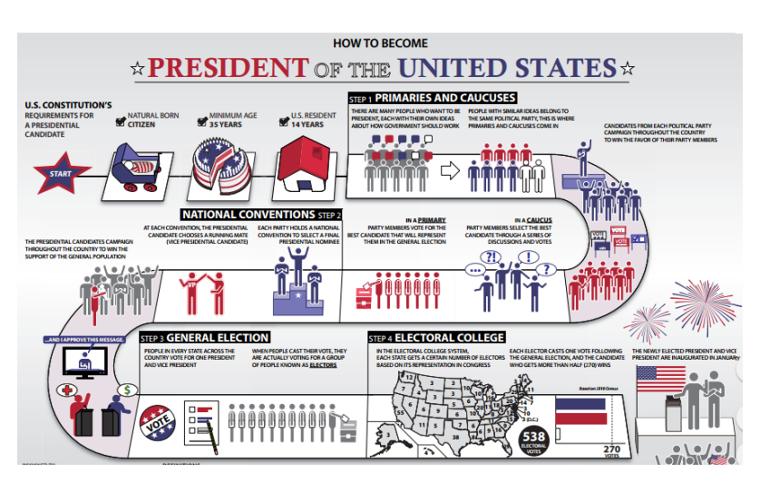

Slide 4


Initial Requirements
35 Years old
Born in the U.S.A.
U.S.A. Citizen/Resident of U.S. for 14 years

Slide 5
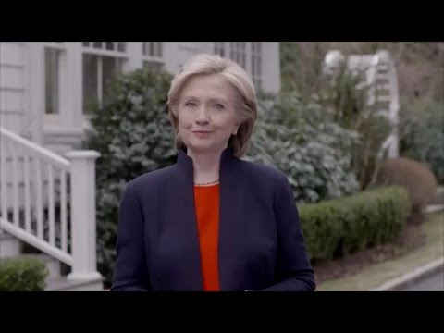
Journey to the White House: Stop #1
Spring of the year BEFORE an election:
Candidates announce intentions to run for the office of President of the United States

Slide 6

Journey to the White House: Stop 2
Summer before election year to Spring of election year
Primary and caucus debates take place

Slide 7


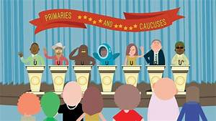
Journey to the White House: Stop 3
January to June of Election Year
States and parties hold primaries and caucuses
Primary v Caucus
Click on the pictures for video links

Slide 8
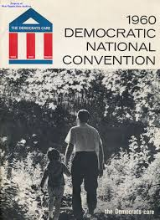
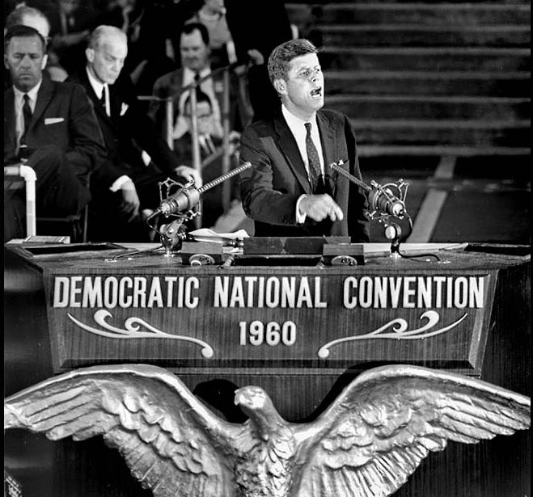
Journey to the White House: Stop 4
July to early September
Parties hold nominating conventions to choose their candidates
Click here

Slide 9

Journey to the White House: Stop 5
September to October
Candidates participate in presidential debates

Slide 10


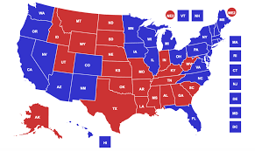

Journey to the White House: Stop 6
Early November
ELECTION DAY

Slide 11

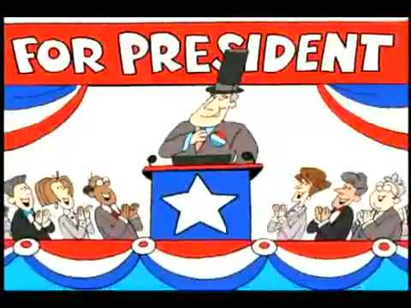
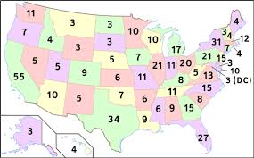
Journey to the White House: Stop 7
December
Electors cast their votes in the Electoral College

Slide 12
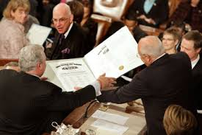
Journey to the White House: Stop 8
Early January following election year
Congress counts electoral votes
Click on picture for video

Slide 13
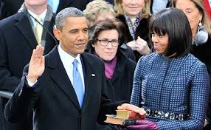
Journey to the White House: Stop 9
January 20
INAUGURATION DAY
Kennedy Inauguration
“ I do solemnly swear that I will faithfully execute the office of President of the United States and will, to the best of my ability, preserve, protect and defend the Constitution of the United States.”

Slide 14
Credits
This slide show has been created using information from the www.kids.gov website.
NH Primary Image: http://www.123rf.com/clipart-vector/primary_election.html
Primary Fever Image: http://www.bradfitzpatrick.com/magazine-illustration-spot-illustrations/new-hampshire-primary-election-fever-illustration/
1960 Democratic Convention images:
http://framework.latimes.com/2012/09/03/1960-democratic-national-convention-in-los-angeles/
http://www.wvculture.org/history/1960presidentialcampaign/images/jfkdoc060.html
Debate Image: https://mediaplanet.azureedge.net/images/318/53018/social-2016-trump-hil.jpg
Election Day Images:
http://www.allthingsclipart.com/03/election.day.04.jpg
https://www.askideas.com/media/65/November-8-2016-Election-Day-In-United-States.jpg
https://www.amalgamatedbank.com/amalgamated-bank-teams-rock-vote
https://caffeinatedthoughts.com/wp-content/uploads/2016/07/Screenshot-2016-07-22-18.40.17-1024x608.png
Electoral College Images:
http://swh.schoolworkhelper.netdna-cdn.com/wp-content/uploads/2010/08/electoral-college-map.gif?x37075
http://www.paretopolitics.com/uploads/4/7/0/9/47091401/452559287_orig.png
Counting Votes Image: http://s.hswstatic.com/gif/us-electoral-college-1.jpg
Inauguration Image: http://static.guim.co.uk/sys-images/Guardian/Pix/pictures/2013/1/21/1358795319262/Obama-inauguration-010.jpg

Slide 15

As you can see, the Journey to the White House has many “stops” and takes many months.
Sit back, relax, and enjoy the book, Grace for President by Kelly Dipucchio

Slide 16
You have learned a lot about running for office and how the election process works. It is time for you to put your knowledge into action.
Your teacher will give you directions about how to enjoy this simulation game called, “Win the White House”.
CLICK HERE TO ACCESS THE GAME
Win the White House

Slide 17
Win the White House Campaign: Reflections
Answer the following questions in complete sentences. Remember to use proper capitalization and punctuation.
What was the best part of the Win the White House Campaign? Why?
Describe your experience during the campaign process. What were some hurdles you had to overcome? Did anything limit your ability to campaign successfully?
Was you campaign successful? Why or why not?
TYPE HERE
TYPE HERE

Slide 18
3. What was the most difficult part of debating?
4. Was you campaign successful? Why or why not?
TYPE HERE
TYPE HERE

Slide 19

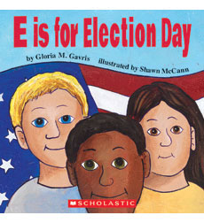

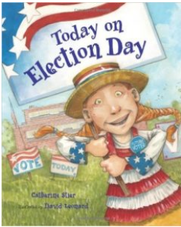

Click on a book to listen to the story.

