Slide 1
THE CONSTITUTION OF THE UNITED STATES OF AMERICA
Rules of our country

Slide 2
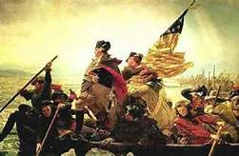
We won the war but now what?
We won the war!
We have no leader
Do we want a king/queen?
  We hated the king of England?
  What if they are not good leader?
  What are we going to do?

Slide 3
Problem
Each state had its own rules
NH rules would be different then Mass
We wanted make sure someone did not be come tooooo powerful!
We made a government that checks each other

Slide 4

US constitution
Leaders came to meet about the Constitution
Much fighting
Three branches of Government
James Madison Wrote the document

Slide 5
Words or Ideas
James Madison wrote about Ideas and principles he wanted the US to stand for
Here are a few of his ideas

Slide 6

Union
Work together
To come together
United
Whole country not small parts
Same rules

Slide 7
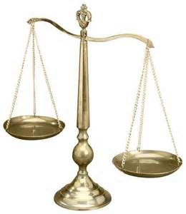
Justice
Judge
Fair
Fair Trial
To have right to fair treatment
fairness

Slide 8


Tranquility
Peace
Peaceful
Calm
Peacefulness

Slide 9
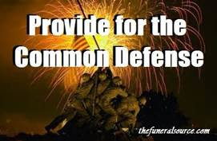
Common Defense
Protect
Protection
Army
Right to protect our selves

Slide 10
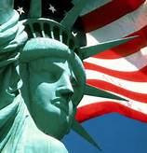
Blessings of Liberty
FREEDOM
Freedom
right to choose
the freedom to think or act on your own
Freedom
Right to vote

Slide 11

to ourselves and our Posterity,
WE want
Us and our children
Freedom
Peace
Protection
Fair
Fair trial

Slide 12
Rights
We have the Right to:

Slide 13
Rules
We have rules to follow for safety

