Slide 1
Constitutional Values
Judicial Review, Constitutional Interpretation, and Freedom of Speech and the First Amendment
Adopted for remote learning by Corey Genest

Slide 2
Judicial Review
The doctrine under which the actions of the executive and
legislative branches of government are subject to review
and possible invalidation by the judicial branch. Judicial
review allows the Supreme Court to take an active role in
ensuring that laws and executive actions conform with the
U.S. Constitution.

Slide 3
SCOTUS & Judicial Review
Please take some time to read and review Article III of the Constitution. After you finish reading, carefully respond to the questions that follow on the proceeding pages.
Article III
of the
United States Constitution

Slide 4
Under Article III, what are the roles, responsibilities, and powers of the Supreme Court? Are there any limitations? Explain.
[type answer here]

Slide 5
Does Article III give the Supreme Court authority to determine if acts of the executive branch, legislative branch, or the states are constitutional? Where? Explain.
[type answer here]

Slide 6
Does Article III give the Supreme Court the authority to invalidate laws passed by Congress or states if those measures do not comport with the Constitution?
[type answer here]

Slide 7
In your own words, describe what you understand the role of the Supreme Court to be under Article III of the United States Constitution.
[type answer here]

Slide 8
Marbury v Madison
Establishing the precedent for Judicial Review in the United States

Slide 9
Marbury v Madison
Please take some time to review the SCOTUS ruling on Marbury v Madison. After your reading of the ruling visit Oyez.org to read their synopsis. Then please answer the questions on the following slides.
Marbury v Madison at Cornell Law
Marbury v Madison Summary at Oyez.org

Slide 10
What did the Court hold in Marbury v. Madison? Why is it such an important case in United States history? Did the outcome enhance or erode the system of checks and balances created by the Constitution?
[type answer here]

Slide 11
Constitutional Interpretation
On the following slides, please read each scenario.
After you read, decide if each action is constitutional and then cite the Article, Section, Clause, or Amendment of the Constitution that supports your conclusion, typing your answers in the available box.

Slide 12
After protesters in New York City burn the United States flag, Congress passes a Flag Desecration Act banning any display of contempt directed against the flag.
[type answer here]

Slide 13
New Hampshire passes the Separate Car Act declaring that all forms of transit carrying passengers must provide separate but equal accommodations for white and nonwhite passengers. Passengers sitting in the wrong shuttle must pay a $250 fine or face 30 days in jail.
[type answer here]

Slide 14
Congress passes a law banning the sale of guns to those who have been deemed dangerous to themselves or others, involuntarily committed, found not guilty by reason of insanity, or judged incompetent to stand trial.
[type answer here]

Slide 15
The state of Texas adopts an amendment to its state constitution recognizing marriage as between one man and one woman. The amendment also states that Texas may not create or recognize any legal status identical or similar to marriage.
[type answer here]

Slide 16
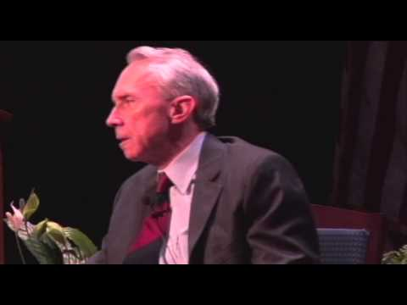
Retired Justice David Souter
Please answer the follow-up questions on the proceeding slides.

Slide 17
According to Justice Souter, in what way does the United States have two Constitutions? What does he refer to these as and what are the characteristics of each?
[type answer here]

Slide 18
What does Justice Souter mean by the following statement:
“These general terms, I think, are best understood as kind of a listing or a menu of approved values, the application of which has got to be worked out over time.”
[type answer here]

Slide 19
Does Justice Souter’s understanding expand or restrict the Court’s ability to interpret the language in the Constitution?
[type answer here]

Slide 20
What assignment did Justice Souter suggest was left to the future? What does this mean and what does it suggest about Justice Souter’s perception of the Constitution?
[type answer here]

Slide 21
One more interpretation: What do you think?

Slide 22
In 1791, when the Bill of Rights was adopted, the death penalty was a widely accepted practice. Would you consider it acceptable for the U.S. Supreme Court to abolish the death penalty if modern society viewed the practice as “cruel and unusual,” or do you think a constitutional amendment should be required to abolish the death penalty?
[type answer here]

Slide 23
The First Amendment & Freedom of Speech
What values does the First Amendment seek to promote?

Slide 24
Congress shall make no law respecting an establishment of religion, or prohibiting the free exercise thereof; or abridging the freedom of speech, or of the press; or the right of the people peaceably to assemble, and to petition the government for a redress of grievances.
Something to think about:
When
and
why
should the government restrict the first amendment?

Slide 25
Religion
Assembly
Press
Petition
Speech
This sums up the freedoms of the first amendment. But let’s focus on that last one...

Slide 26
Have a conversation with one or more people at home about the following questions. Afterward, write a synopsis of the conversation on the slides that follow..
Do you think that your definition of free speech is the same as your parents? Your grandparents? Why or why not?
Why do you think people have different perspectives on free speech?
How has technological advancement made this a more important question today than it has been in the past?
What factors may affect how a person views free speech? Where did your opinion come from - in other words, from whom and when did you learn what was considered free speech?
Why do people disagree about when it is acceptable for the government to limit a person's speech?

Slide 27
Synopsis of 1st Amendment Conversation
[type here]

Slide 28
Synopsis (continued)
[type here]

Slide 29
Synopsis (continued)
[type here]

Slide 30
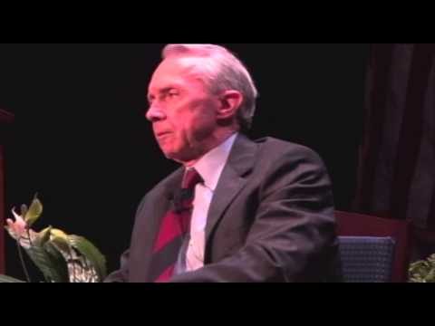
Free speech contextualized in the Constitution

Slide 31
Do you agree with Justice Souter’s assessment that if First Amendment is limited narrowly it is not going to mean very much?
[type answer here]

Slide 32
In his dissent in Abrams v. United States (1919), Justice Oliver Wendell Holmes wrote the following:
“But when men have realized that time has upset many fighting faiths, they may come to believe even more than they believe the very foundations of their own conduct that the ultimate good desired is better reached by free trade in ideas -- that the best test of truth is the power of the thought to get itself accepted in the competition of the market, and that truth is the only ground upon which their wishes safely can be carried out. That, at any rate, is the theory of our Constitution.”

Slide 33
What does Holmes mean by this and how does it relate to the First Amendment?
How might life be different if the First Amendment were absolute?
[type answer here]

