Slide 1
Equality and the Constitution
Understanding the Fourteenth Amendment
Adopted for remote learning by Corey Genest

Slide 2
We hold these truths to be self-evident, that all men are created equal, that they are endowed by their Creator with certain unalienable Rights, that among these are Life, Liberty and the pursuit of Happiness.
The Declaration of Independence

Slide 3
To whom do you think this applied to when it was written? To whom did it not?
[Type here]

Slide 4
Define equality
[enter your definition of equality here]

Slide 5
Food for thought
Does the word equality mean different things to different people? Why?
Does treating people equally mean treating them the same?
Is equality a desirable outcome for society? Why or why not? Explain.
Is equality an achievable outcome for society? Why or why not? Explain?
Is equality an inherent right of all people?
On the next slide, identify ways in which people were treated differently historically in one column and how people are treated differently today in another.

Slide 6
Inequality in the past… Inequality in the present...
[type here]
[type here]

Slide 7
The Fourteenth Amendment
Adopted July 9, 1868
Equal Protection and Citizenship
It reads...

Slide 8
“All persons born or naturalized in the United States, and subject to the jurisdiction thereof, are citizens of the United States and of the state wherein they reside. No state shall make or enforce any law which shall abridge the privileges or immunities of citizens of the United States; nor shall any state deprive any person of life, liberty, or property, without due process of law; nor deny to any person within its jurisdiction the equal protection of the laws.”

Slide 9
Please rewrite the amendment, capturing its spirit...
[type here]

Slide 10
SCOTUS Interpretation of the 14th Amendment
Dred Scott v Sandford
Plessy v Ferguson
Brown v Board of Education
Please take some time to review the Supreme Court cases on the left. How has the court’s interpretation of equality changed over time?
Nowhere does the Constitution explicitly mention equality. So, what mandate does the SCOTUS to ensure equality?

Slide 11
Food for Thought
How did the Court’s interpretation of equality change over time?
How did the Court’s interpretation of the Fourteenth Amendment change over time?
What factors led the Court to rule the way it did in each of these cases? Do you think Americans’ concept of equality played a role?
How might society be different today if “separate but equal” had remained constitutional?
The living, evolving Constitution.

Slide 12
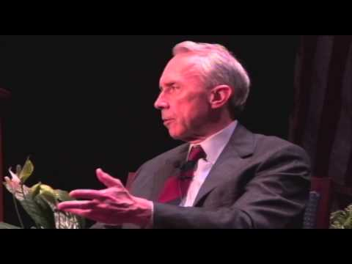
Choice of Principles
Justice David Souter
Please watch this short presentation and answer the questions that follow.

Slide 13
1. How did the Court’s view of equality change between Plessy v. Ferguson and Brown v. Board of Education?
[type here]

Slide 14
2. Why does Justice Souter believe it is unrealistic and unfair to suggest Plessy was wrong the day it was decided?
[type here]

Slide 15
3. Why is it significant that the Court not only considered the objective, physical, measurable facts in Brown v. Board of Education, but also what those facts meant?
[type here]

Slide 16
4. How can “what we see” affect how the Supreme Court interprets the meaning of the Constitution and its specific provisions?
[type here]

Slide 17
5. Why did the Warren Court consider separate but equal educational facilities inherently unequal in Brown v. Board of Education?
[type here]

Slide 18
6. How does our capacity to determine the meaning of facts change over time?
[type here]

Slide 19
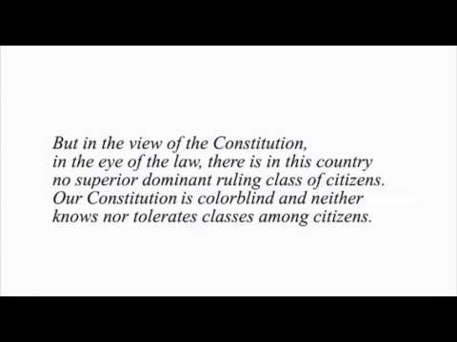
Plessy v Ferguson: The Dissenting Opinion
Please read excerpts from Justice Harlan’s dissent here and then watch the following short clip:

Slide 20
1. Explain the competing concepts of color blindness espoused by Justice Harlan in his dissent in Plessy v. Ferguson (1896).
2. Are Justice Harlan’s words regarding race in America encouraging or discouraging given the historical and political context of the case?
3. How do Justice Harlan’s words illustrate Justice David Souter’s assertion that our understanding of the Constitution changes over time?
4. Did Justice Harlan’s Dissenting Opinion have a significant impact on the outcome of Brown v. Board of Education (1954)?
[type here]

Slide 21
Equality and Equal Treatment
Is it consistent with the constitutional value of equality to give some people a preference in order to make a particular community more diverse?

Slide 22
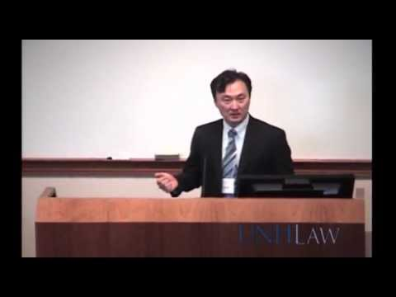
Please listen to Professor Shin discuss affirmative action in higher education.
Afterward, please answer the questions that follow.

Slide 23
Is it in conflict with the constitutional value of equality to give underrepresented populations a “boost” in order to achieve diversity?
[type here]

Slide 24
What is affirmative action and what is its purpose or goal?
[type here]

Slide 25
Why did the Supreme Court find affirmative action within higher education consistent with the constitutional value of equality?
[type here]

Slide 26
Does diversity serve the constitutional value of equality?
[type here]

Slide 27
Is affirmative action justifiable outside of higher education?
[type here]

Slide 28
Congress and the Presidency: Affirmative Action
Using the 3 APPARTS worksheets that follow this page, please review the legislative and executive decisions (links on the right of this page) regarding affirmative action.
Please read all 5 actions, but complete 3 APPARTS worksheets.
If you are unfamiliar with how to use an APPARTS tool, you can learn with this video.
Executive Order 10925
Executive Order 11246
Civil Rights Act of 1964
Voting Rights Act of 1965
Title IX of The Education Amendments of 1972

Slide 29
APPARTS
[enter legislative or executive action here]
Author
Place & Time | [type here]
Prior Knowledge | [type here]
Audience | [type here]
Reasons | [type here]
The Main Idea | [type here]
Significance | [type here]
[type here]

Slide 30
APPARTS
[enter legislative or executive action here]
Author
Place & Time | [type here]
Prior Knowledge | [type here]
Audience | [type here]
Reasons | [type here]
The Main Idea | [type here]
Significance | [type here]
[type here]

Slide 31
APPARTS
[enter legislative or executive action here]
Author
Place & Time | [type here]
Prior Knowledge | [type here]
Audience | [type here]
Reasons | [type here]
The Main Idea | [type here]
Significance | [type here]
[type here]

Slide 32
SCOTUS and Affirmative Action
On the next page is a list of Supreme Court rulings on the issue of affirmative action. As you read the decisions and summaries, consider the following:
How has the Supreme Court’s interpretation of equality and affirmative action changed over time?

Slide 33
Regents of the University of California v. Bakke (1978) Full Text Summary
United Steel Workers of America v. Weber (1979) Full Text Summary
Fullilove v. Klutznick (1980) Full Text Summary
Memphis Fire Department v. Stotts (1984) Full Text Summary
Wygant v. Jackson Board of Education (1986) Full Text Summary
U.S. v. Paradise (1987) Full Text Summary
Johnson v. Transportation Agency (1987) Full Text Summary
City of Richmond v. Croson (1989) Full Text Summary
Adarand Constructors v. Pena (1995) Full Text Summary
Grutter v. Bollinger (2003) Full Text Summary
Gratz v. Bollinger (2003) Full Text Summary
Fisher v. University of Texas** (2013) Full Text Summary

Slide 34
How has the Supreme Court’s interpretation of equality and affirmative action changed over time? Please provide an answer using specific examples from the decisions.
[type here]

