Slide 1
Do you know your rights?
Why are the rights guaranteed to citizens in the United States important in ensuring liberty?
Author: Marie Gagnon
Adopted for remote learning by Corey Genest

Slide 2
The Bill of Rights
The most significant objection to the ratification of the Constitution was the lack of a Bill of Rights. Ultimately, the Bill of Rights was ratified in 1791, and now limits were placed on the new American government. Please review the Bill of Rights (link provided on the right).
The Bill of Rights

Slide 3
Understanding the Bill of Rights
On the following ten slides, please complete the empty cells, answering the following questions:
...the first 10 amendments to the United States Constitution.

Slide 4
What was the origin of the amendment (i.e. what historical circumstances created interest in creating this protected right?)
How does this right provide citizens with liberty and what are some examples of this amendment in action?
When has this right’s protections being questioned or limited by the Supreme Court? Why was the right’s protections questioned or limited?

Slide 5
Useful Resources...
The Bill of Rights at Cornell Law
(provides in depth analysis of each amendment)
Oyez.org
(search any SCOTUS case)
...to assist you with your study and understanding of the Bill of Rights, as well as your ability to answer the aforementioned questions.

Slide 6
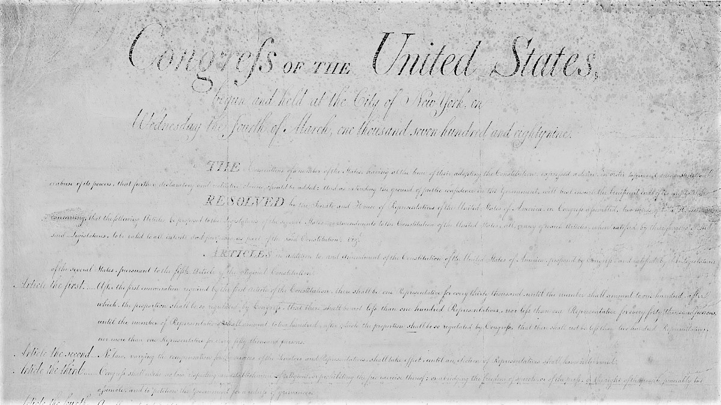
1st
What is the origin of this amendment? [type here]
How does this right provide liberty? Provide an example of when it has provided the liberty. [type here]
When has this amendment been questioned or limited (cite a SCOTUS ruling)? Why was the amendment questioned or limited? [type here]

Slide 7
2nd
What is the origin of this amendment? [type here]
How does this right provide liberty? Provide an example of when it has provided the liberty. [type here]
When has this amendment been questioned or limited (cite a SCOTUS ruling)? Why was the amendment questioned or limited? [type here]

Slide 8
3rd
What is the origin of this amendment? [type here]
How does this right provide liberty? Provide an example of when it has provided the liberty. [type here]
When has this amendment been questioned or limited (cite a SCOTUS ruling)? Why was the amendment questioned or limited? [type here]

Slide 9
4th
What is the origin of this amendment? [type here]
How does this right provide liberty? Provide an example of when it has provided the liberty. [type here]
When has this amendment been questioned or limited (cite a SCOTUS ruling)? Why was the amendment questioned or limited? [type here]

Slide 10
5th
What is the origin of this amendment? [type here]
How does this right provide liberty? Provide an example of when it has provided the liberty. [type here]
When has this amendment been questioned or limited (cite a SCOTUS ruling)? Why was the amendment questioned or limited? [type here]

Slide 11
6th
What is the origin of this amendment? [type here]
How does this right provide liberty? Provide an example of when it has provided the liberty. [type here]
When has this amendment been questioned or limited (cite a SCOTUS ruling)? Why was the amendment questioned or limited? [type here]

Slide 12
7th
What is the origin of this amendment? [type here]
How does this right provide liberty? Provide an example of when it has provided the liberty. [type here]
When has this amendment been questioned or limited (cite a SCOTUS ruling)? Why was the amendment questioned or limited? [type here]

Slide 13
8th
What is the origin of this amendment? [type here]
How does this right provide liberty? Provide an example of when it has provided the liberty. [type here]
When has this amendment been questioned or limited (cite a SCOTUS ruling)? Why was the amendment questioned or limited? [type here]

Slide 14
9th
What is the origin of this amendment? [type here]
How does this right provide liberty? Provide an example of when it has provided the liberty. [type here]
When has this amendment been questioned or limited (cite a SCOTUS ruling)? Why was the amendment questioned or limited? [type here]

Slide 15
10th
What is the origin of this amendment? [type here]
How does this right provide liberty? Provide an example of when it has provided the liberty. [type here]
When has this amendment been questioned or limited (cite a SCOTUS ruling)? Why was the amendment questioned or limited? [type here]

