Slide 1
Empowering Connected Citizenship
What responsibility do legislators have to their constituency
after they have been elected?
Author: Laura Derosa
Adopted for remote learning by Corey Genest

Slide 2
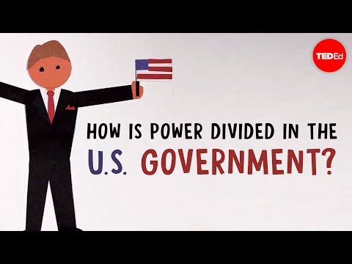
A quick review...
...of our government.

Slide 3
Where do laws come from?
Who can propose laws?
What role do citizens play?

Slide 4
Using the links below, research bills in nh.
NH General Court
Using the search tools at these links, find bills that pertain to areas of interest to you (issues of environment, health care, education, etc)
Citizen’s Count

Slide 5
Choose six bills that you have researched and provide a summary of them on the following pages.

Slide 6
[type here]
[type here]
[type here]
[type here]
[type here]
[type here]
Bill Name and Number:
Bill Name and Number:
Bill Sponsor (legislator):
Bill Sponsor (legislator):
Intention (what will it do?):
Intention (what will it do?):

Slide 7
[type here]
[type here]
[type here]
[type here]
[type here]
[type here]
Bill Name and Number:
Bill Name and Number:
Bill Sponsor (legislator):
Bill Sponsor (legislator):
Intention (what will it do?):
Intention (what will it do?):

Slide 8
[type here]
[type here]
[type here]
[type here]
[type here]
[type here]
Bill Name and Number:
Bill Name and Number:
Bill Sponsor (legislator):
Bill Sponsor (legislator):
Intention (what will it do?):
Intention (what will it do?):

Slide 9
Who’s your legislator?
NH General Court Roll
Using the link on the right, look up who your state legislator is.

Slide 10
Choose one bill you researched...
...and complete the questions on the next two slides please.

Slide 11
[type here]
[type here]
[type here]
Bill Name and Number:
What effect will this bill have?
[type here]
Supporters:
Detractors:

Slide 12
Write your legislator.

Slide 13
Please write a one page letter to your legislator.
Your letter should be properly formatted and address the following areas:
Your understanding of the purpose of the bill.
The arguments for and against the bill.
Your argument for or against the bill. You can include the views of others, but strive to develop your own independent opinion of the bill.

