Slide 1
Federalism
The balance of power between the federal and state governments...
Adopted for remote learning by Corey Genest

Slide 2
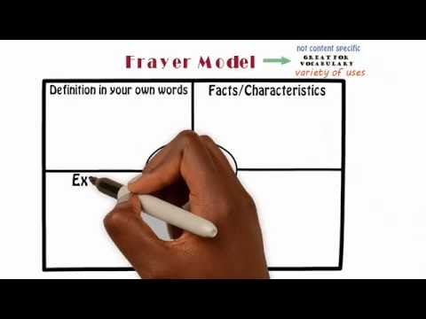
Compromise
On the following slide, please complete the Frayer model to help with your understanding of the definition of compromise.
To the right is a short video that explains how to create a Frayer model if you are unsure how to do so.

Slide 3
[type here]
[type here]
Definition
Characteristics
Compromise
Examples
Non-examples
[type here]
[type here]

Slide 4

A Lesson in Compromise
Justice David Souter

Slide 5
A Lesson in Compromise: Questions (1)
According to Justice Souter, what did James Madison believe was the most serious issue facing the Constitutional Convention in 1787? Do you agree or disagree with Justice Souter's assessment? Why?
[type answer here]

Slide 6
A Lesson in Compromise: Questions (2)
What were some of the compromises made by the delegates at the Constitutional Convention of 1787? Are there any common themes you can identify?
[type answer here]

Slide 7
A Lesson in Compromise: Questions (3)
“So compromise matters, it's fundamental to debate, to the way we govern. We've seen, I think both at the national level and here in New Hampshire, what happens when people are unwilling to compromise." - William Chapman, Esq., Shareholder, Orr & Reno
What did Attorney Chapman mean when he stated that compromise is "fundamental to debate, to the way we govern"? Provide a recent example in which government officials were unwilling to compromise and describe how the lack of compromise affected the government and our society.
[type answer here]

Slide 8
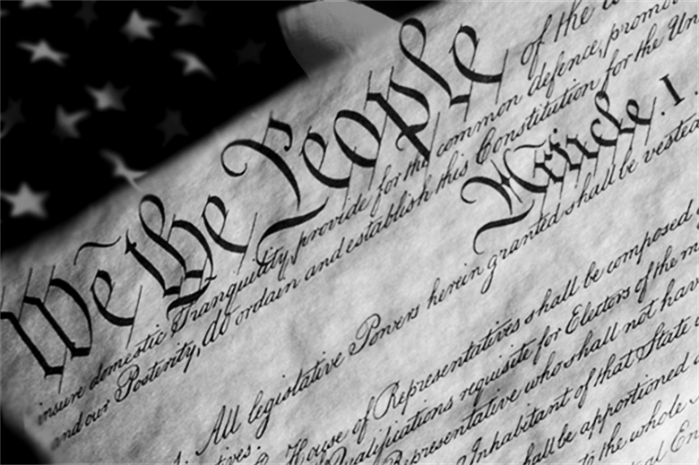
What compromises were made during the creation of the U.S. Constitution and why were those compromises necessary?
A More Perfect Union
Think about this question as you read the document on the right.

Slide 9
Federalism
A system of government where power is divided between a national government and smaller regional governments (i.e. state governments in the United States). In the United States, the national or federal government has exclusive power in some areas, the state governments have exclusive power in some areas, and the two levels of government share power in other areas. This is called a federal system of government.

Slide 10
Federal Powers Granted | Shared Powers | State Powers Granted
[type here] | [type here] | [type here]
Construct a chart illustrating powers granted to and shared by state and federal government.

Slide 11
Federal Powers Denied | Denied Powers to both | State Powers Denied
[type here] | [type here] | [type here]
Construct a chart illustrating powers denied to state and federal government.

Slide 12
When a state passes a law contradicting a federal law, which law has supremacy? Where in the Constitution is this issue addressed?
Are there powers delegated to the federal government that you think should be left to the states? If so, why?
Are there powers reserved to the states that you think should be exercised by the federal government? If so, why?
Is a sharing of some powers between the federal and state governments an effective way to govern? Why or why not?
[enter answer to question 1 here]
[enter answer to question 2 here]
[enter answer to question 3 here]
[enter answer to question 4 here]

Slide 13
Analyzing the Necessary and Proper Clause and the Commerce Clause of the Constitution

Slide 14
SCOTUS Rulings
Necessary and Proper Clause
McCulloch v. Maryland (1819) Full Text Summary U.S. v. Comstock (2010) Full Text Summary
Commerce Clause
Gibbons v. Ogden (1824) Full Text Summary Swift v. U.S. (1905) Full Text Summary Schechter Poultry Corp. v. U.S. (1935) Full Text Summary NLRB v. Jones (1937) Full Text Summary Wickard v. Filburn (1942) Full Text Summary U.S. v. Lopez (1995) Full Text Summary U.S. v. Morrison (2000) Full Text Summary Affordable Care Act cases (2012) Full Text Summary
Please choose two of the cases on the right to review. After reading, you must provide analysis by answering the following questions:
The facts of the case, including the federal law or action that is at the center of this case.
The central question of the case? (i.e. “The Supreme Court must decide if...”)
The ruling of the Court.
How the text of the Constitution was interpreted to support the Court’s ruling.

Slide 15
[enter answer here]
Which case did you choose for the Necessary and Proper Clause and what are the facts of the case, including the federal law or action that is at the center of this case.

Slide 16
[enter answer here]
b) What is the central question of the case? (i.e. “The Supreme Court must decide if...”)

Slide 17
[enter answer here]
c) What was the ruling of the Court.

Slide 18
[enter answer here]
d) How was the text of the Constitution interpreted to support the Court’s ruling.

Slide 19
[enter answer here]
Which case did you choose to for the Commerce Clause and what are the facts of the case, including the federal law or action that is at the center of this case.

Slide 20
[enter answer here]
b) What is the central question of the case? (i.e. “The Supreme Court must decide if...”)

Slide 21
[enter answer here]
c) What was the ruling of the Court.

Slide 22
[enter answer here]
d) How was the text of the Constitution interpreted to support the Court’s ruling.

Slide 23
Voting Rights and the Constitution
To start, on the following slide please complete the graphic organizer to develop a definition of voting.

Slide 24
[type here]
[type here]
Definition
Characteristics
Voting
Examples
Non-examples
[type here]
[type here]

Slide 25
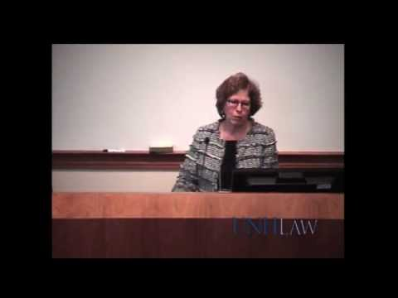
A Precious Right
How do the federal government and states share power over voting and election laws?
How did the Voting Rights Act of 1965 improve access to voting for minorities in the United States?

Slide 26
SCOTUS and Voting Rights
Please review the cases on the right. These cases help us trace the evolution of voting rights in America over the past 50 years. After you have reviewed the cases, use the following slides to analyze that evolution.
Harper v. Virginia Board of Elections (1966) Full Text Summary
Bush v. Gore (2000) Full Text Summary
Crawford v. Marion County Election Board (2008) Full Text Summary
Shelby County v. Holder (2013) Full Text Summary

Slide 27
[enter answer here]
What significant changes to voting rights in the United States have occurred in the last 50 years?

Slide 28
[enter answer here]
What are the challenges facing states today when it comes to regulating the voting process? What are the challenges facing the federal government?

Slide 29
[enter answer here]
Do state governments have more or less power to regulate voting today than they did 50 years ago?

Slide 30
[enter answer here]
Does the federal government have more or less power to regulate voting today than they did 50 years ago?

Slide 31
[enter answer here]
Is voting in the United States today more or less fair than it was 50 years ago? 10 years ago?

