Slide 1
Federalism and Conditional Spending Programs
Adapted from “Money, Democracy and the Constitution” by Chris Herr and Tristan Black-Ingersoll; unit two
Adopted for remote learning by Corey Genest

Slide 2
Do federal conditional spending programs violate the principles of federalism embodied in the Constitution?

Slide 3
To start, make lists in response to the questions below:
What are the benefits of a strong central government?
What are the dangers of a strong central government?
[type answer here]
[type answer here]

Slide 4
Do you think it is better to have a strong central government? Why or why not?
[type answer here]

Slide 5
Two Historical Cases:
Jefferson
&
Hamilton

Slide 6
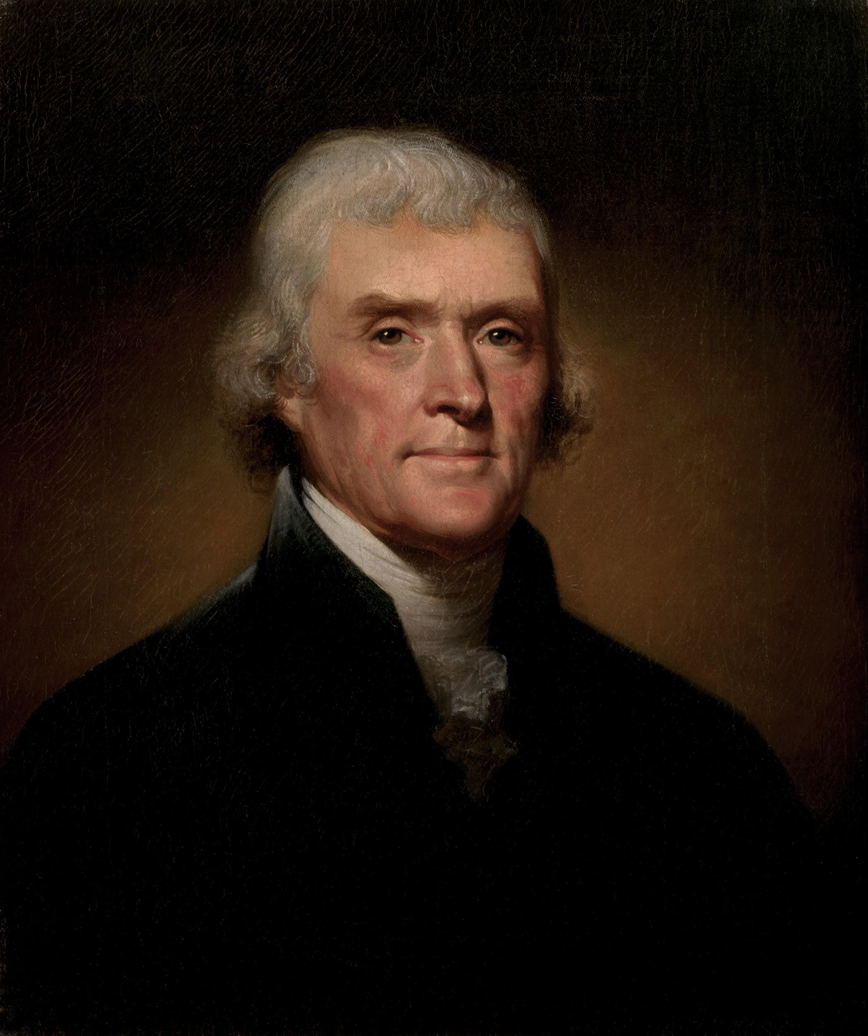
Jefferson
Please utilize internet resources to learn about Thomas Jefferson. On the following slides, answer the questions and cite your sources.

Slide 7
Jefferson bio
When and where did he live?
What different political offices did he occupy?
[enter answer here]
[enter answer here]
What was his life like in his youth?
[enter answer here]
What was his role in the American Revolution?
Sources:
[enter answer here]
[enter answer here]
What are his famous political writings?
[enter answer here]

Slide 8
Jefferson bio
What was his perspective on the role of a national government authority?
[enter answer here]
Summarize his political legacy (i.e. what are his most important political ideas?)
[enter answer here]
Sources:
[enter answer here]

Slide 9

Hamilton
Please utilize internet resources to learn about Alexander Hamilton. On the following slides, answer the questions and cite your sources.

Slide 10
Hamilton bio
When and where did he live?
What different political offices did he occupy?
[enter answer here]
[enter answer here]
What was his life like in his youth?
[enter answer here]
What was his role in the American Revolution?
Sources:
[enter answer here]
[enter answer here]
What are his famous political writings?
[enter answer here]

Slide 11
Hamilton bio
What was his perspective on the role of a national government authority?
[enter answer here]
Summarize his political legacy (i.e. what are his most important political ideas?)
[enter answer here]
Sources:
[enter answer here]

Slide 12
[enter answer here]
In the above space, please compose a paragraph in which you justify either a Hamiltonian or Jeffersonian political opinion. Which of the two views of government do you agree with? Use specific examples to support your opinion.

Slide 13
Does the Constitution create a strong national government or a union of sovereign states?
On the following pages, please view the two videos (one is a hyperlink to a Bowdoin College video series and the other is embedded in the page) and utilize the link to the Constitution. Using these resources please attempt to answer the question on the left.
To show your answer, please complete the graphic organizer that is available on the slide that appears after the links.

Slide 14
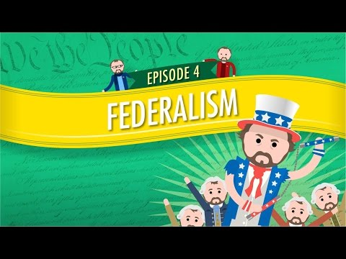
Bowdoin College
Founding Principles Series

Slide 15
Does the Constitution create a strong national government or a union of sovereign states?
[enter your choice here]
Supporting evidence from the videos
[enter evidence here]
Supporting evidence from the Constitution (please cite the Article and Section)
[enter answer here]

Slide 16
Do federal conditional spending programs violate the principles of federalism embodied in the Constitution?

Slide 17
All students who wear either a tuxedo or evening gown to school everyday for the year will have their GPA boosted by one point.
Please outline the pros and cons of the below scenario.
PROS
CONS
[enter answers here]
[enter answers here]

Slide 18
Any person who turns over a handgun to the police will receive a $500 cash payment. No charges will be pursued against any person who turns in a gun obtained illegally.
Please outline the pros and cons of the below scenario.
PROS
CONS
[enter answers here]
[enter answers here]

Slide 19

Please watch this short video to familiarize yourself with health insurance.

Slide 20
Case study
NFIB v Sebelius (2012)
NFIB v Sebelius (2012) - Summary
South Dakota v Dole (1987)
S Dakota v Dole (1987) - Summary
Please analyze these two Supreme Court cases in order to understand the constitutional basis and requirements for conditional spending programs.

Slide 21
Case Study Questions
What requirements must be met for a conditional spending program to be constitutional?
[enter answer here]
Did the program described in the case meet those requirements? Why or why not?
[enter answer here]
Do you agree with the Court’s interpretation and application of the Constitution? Why or why not?
[enter answer here]

