Slide 1
Free Speech and Campaign Finance Regulations
Authors: Chris Herr and Tristan Black-Ingersoll
Adopted for remote learning by Corey Genest

Slide 2
Does the danger of corruption justify restricting the use of money as a form of political speech under the First Amendment?

Slide 3
Warmup: What makes a democracy effective?
[enter your ideas here]

Slide 4
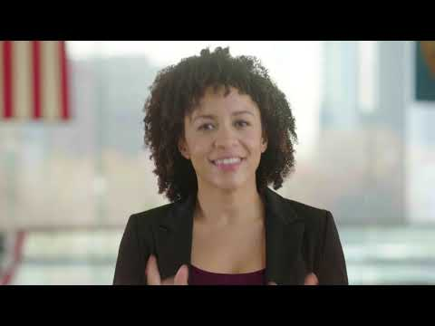
A quick review of the
1st Amendment

Slide 5
Is the first amendment necessary for an effective democracy?
[enter your justified answer here]

Slide 6
Colonial Press and the First Amendment
Please read the article linked in the above headline. Afterward, revisit your answer to the question on the previous slide. Has your opinion changed? Why? Pay attention to the quote from Thomas Jefferson at the beginning of the article.
[your answer here please]

Slide 7
Please watch the video linked below...
[please enter your answer here]
“Why the first Amendment is foremost”
On the left, please answer the following:
Why did the Founders believe that the First Amendment was necessary to an effective democracy?

Slide 8
Please use the resources on the right to consider the following:
“Is the federal election system used in the United States effective?”
Elections
Political Parties
What is the electoral college? (video)
Primary elections explained (video)

Slide 9
Campaign Finance Regulations
To what
extent should financial
donations to political entities
be protected as free speech under the
First Amendment?

Slide 10
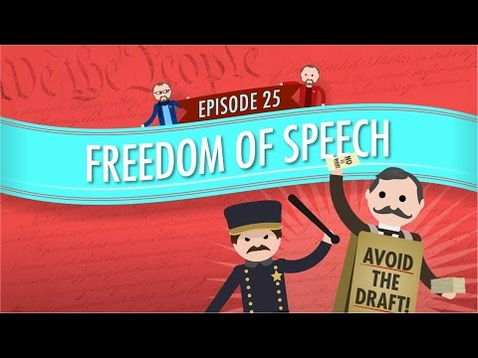
Freedom of Speech: Government and Politics

Slide 11
Please read each of the following statements. Afterward, drag the x into the box that indicates your opinion on each matter.
Yes
No
If you are driving your car and an oncoming vehicle crashes into you should you be able to sue the driver of the other vehicle?
x
If you are driving your new car and the gas tank explodes and injures you, should you be able sue the corporation that manufactured the car?
x
If you are driving your new car and the gas tank explodes and injures you, should you be able to sue the owners of the corporation that manufactured the car?
x
Should all American citizens have the right to vote in public elections?
x
Should all American corporations have the right to vote in public elections?
x
Should all American residents be allowed to donate money to a political campaign?
x
Should all American corporations be allowed to donate money to a political campaign?
x

Slide 12
Should corporations have the same rights as people?
“When did corporations become people?”
Please take some time to read the article linked at the right.
Think about the following…
“to what extent should corporations be treated as people under the law?”

Slide 13
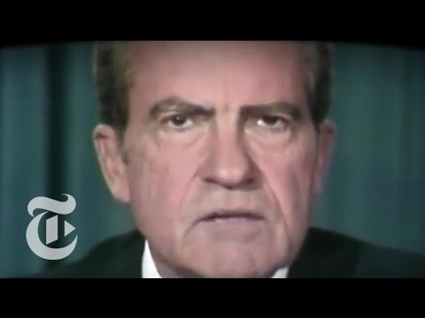
What campaign finance regulations existed before Watergate?
[enter answer here]
How did campaign finance regulations change as a result of Watergate?
[enter answer here]
What is “soft money” and how did it provide a loophole for corporate and individual campaign donations after Watergate? When and how was this loophole eliminated?
[enter answer here]
As you watch, please answer the questions on the right.

Slide 14
SCOTUS and Campaign Finance
How has the Supreme Court ruled in regard to campaign finance law?

Slide 15
Please study the SCOTUS cases on the right.
McConnell v FEC (2003)
McConnell v FEC (2003) Summary
Citizens United v FEC (2010)
McCutcheon v FEC - Summary
Afterward, please take some time to answer the questions on the following slides.

Slide 16
What aspects of campaign finance regulation were affirmed and/or modified by the Court’s decision?
[enter answer here]
Do you agree with the Court’s interpretation and application of the Constitution in this case? Why or why not?
[enter answer here]

