Slide 1
Teacher Notes
Purpose:
By the end of the lesson, students will define the many different parts of our Constitution as evidenced by their completion of the exit slip.
Click here for original lesson.
Constitution Lesson
This lesson has been adapted for students participating in a remote/hybrid model.

Slide 2
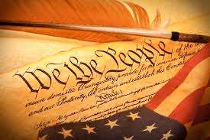
The Constitution of the United States

Slide 3
The Constitution is the framework for the federal government of the United States. It is the highest form of law in the country. The Constitution creates the branches of government and gives them the power to govern. However, it also protects the citizens of the United States and guarantees their basic rights.
From: https://www.ducksters.com/history/us_constitution.php

Slide 4
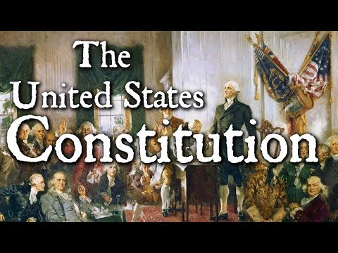

Slide 5

There is so much to learn about the Constitution! To read more about the Articles of Confederation and the Constitutional Convention click below. You can also scroll down the page to select the to li to listen to the selection.
CLICK HERE

Slide 6
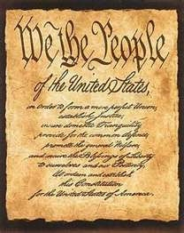
The Preamble to the Constitution
Let’s find out what the Preamble to the Constitution is all about.

Slide 7
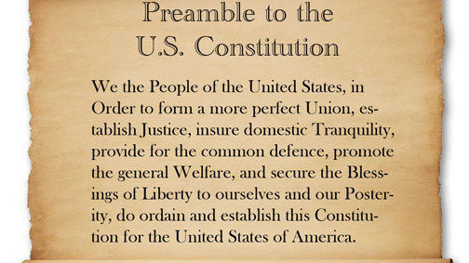

Slide 8
The Preamble to the Constitution introduces the Constitution and sets forth the general purposes for which the government was established. It declares the power of the government comes from the people.

Slide 9
These are the phrases in the Preamble that may be difficult to understand.
perfect union
establish justice
insure domestic tranquility
provide for the common defence
promote the general welfare
secure the blessings of liberty to ourselves and our posterity
Watch the next two videos to help you better understand these phrases.

Slide 10
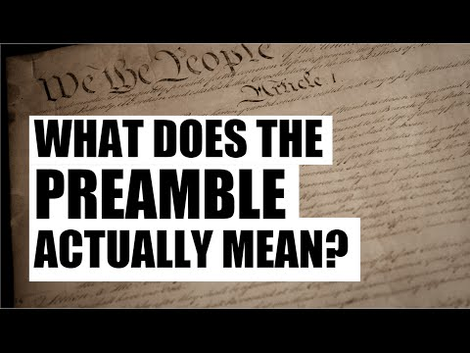

Slide 11
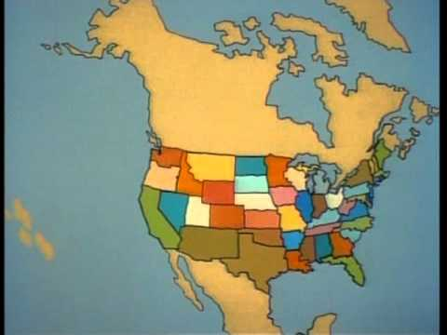

Slide 12
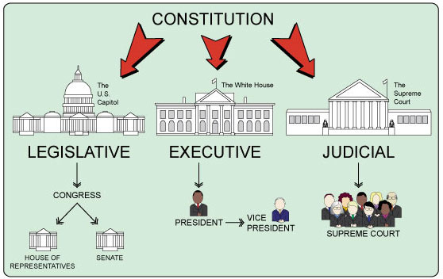
The Constitution divides our government into three branches! Let’s learn about each branch of government.

Slide 13
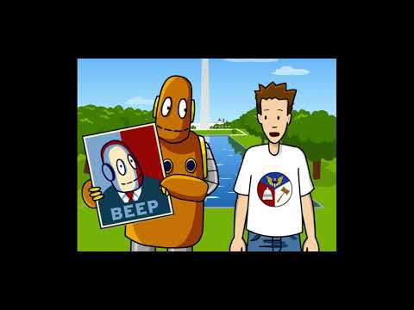
Tim and Moby will teach you about the three branches of government.

Slide 14
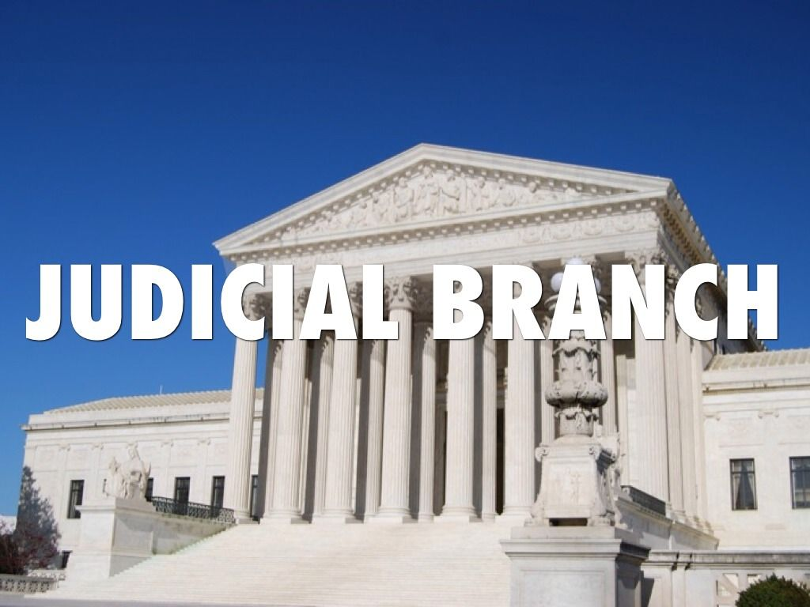
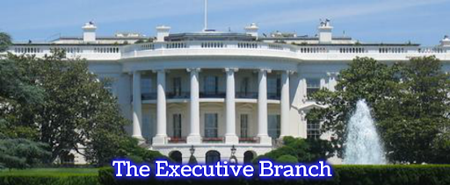
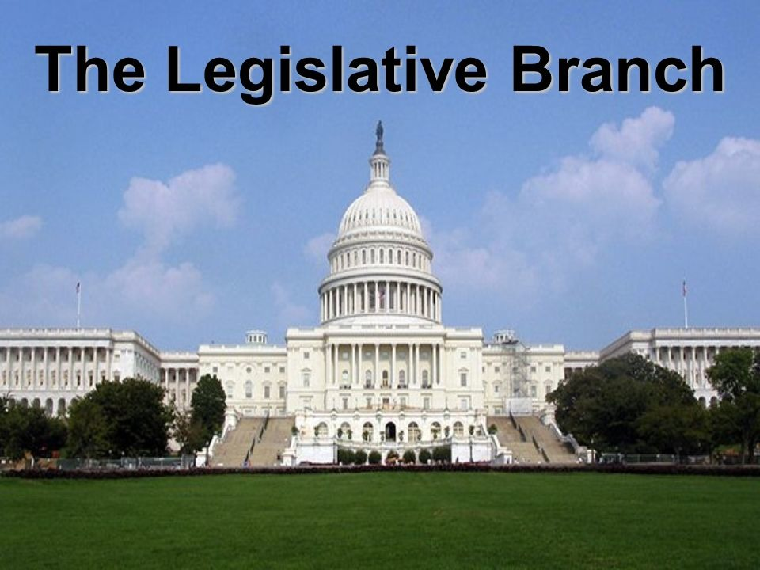
Click and drag the vocabulary word under the Branch of Government to which it belongs.
OTHER FEDERAL COURTS
SUPREME COURT
PRESIDENT
CABINET
VICE PRESIDENT
HOUSE OF REPRESENTATIVES
CONGRESS
SENATE

