Slide 1
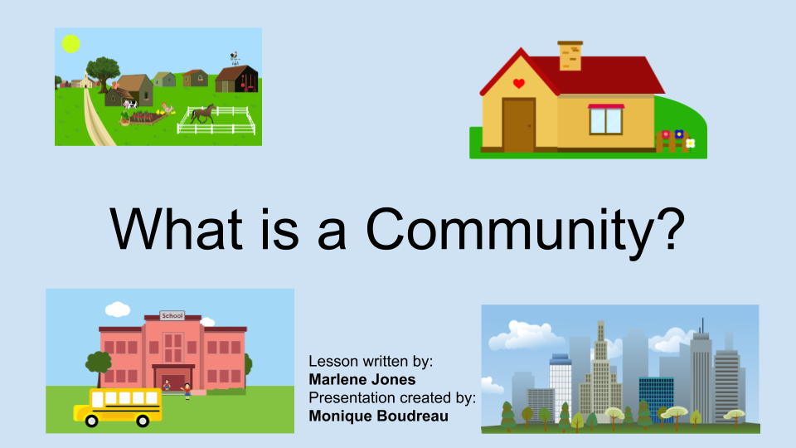

Slide 2
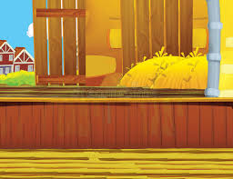

What is a Community?
Click on the picture

Slide 3
What communities are you part of?
In school the principal is in charge.
In the city the mayor is in charge.
What about other places? Who is in charge there?

Slide 4
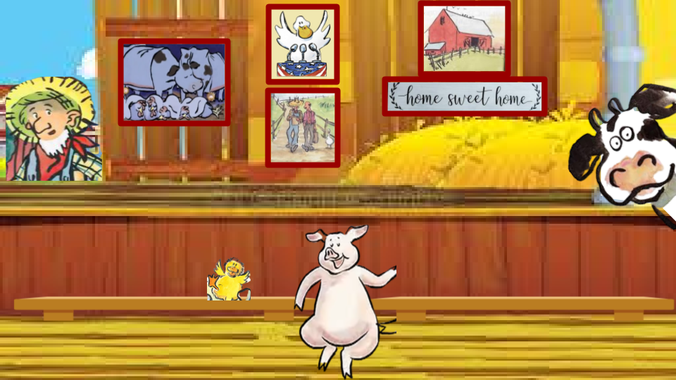

Click on the book

Slide 5
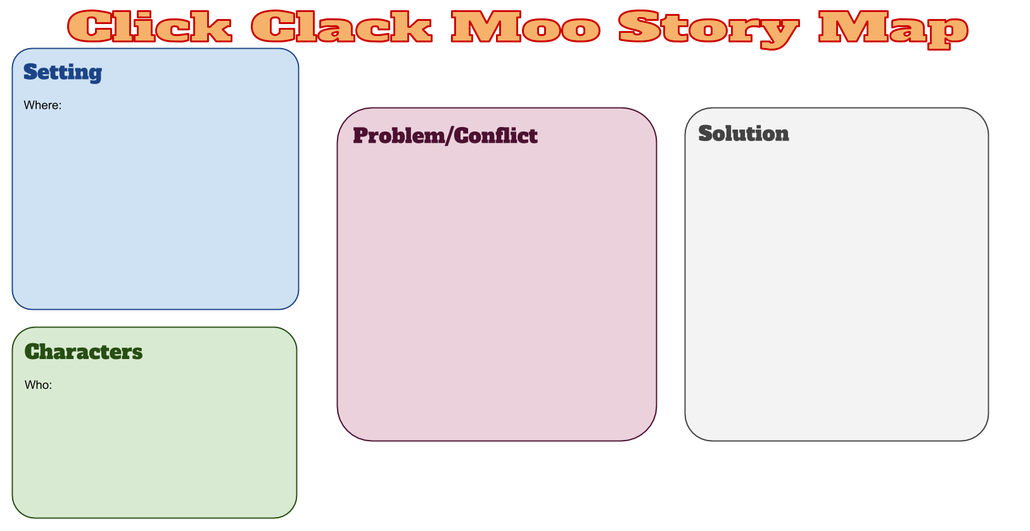
...
Click here if you are going to type your answers.

Slide 6
Turn and Talk
How did the animals work together to solve their problem? How did they get the farmer to change his mind?

Slide 7

Draw your own farm community!

Slide 8
