Slide 1
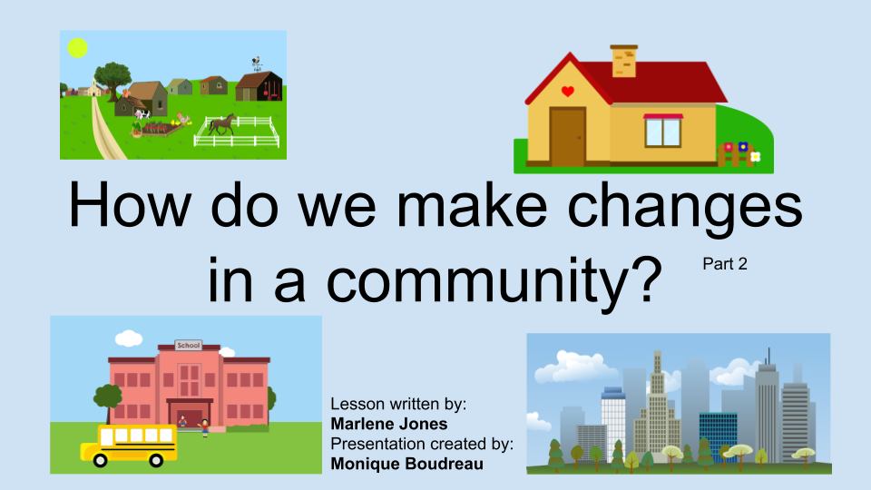

Slide 2
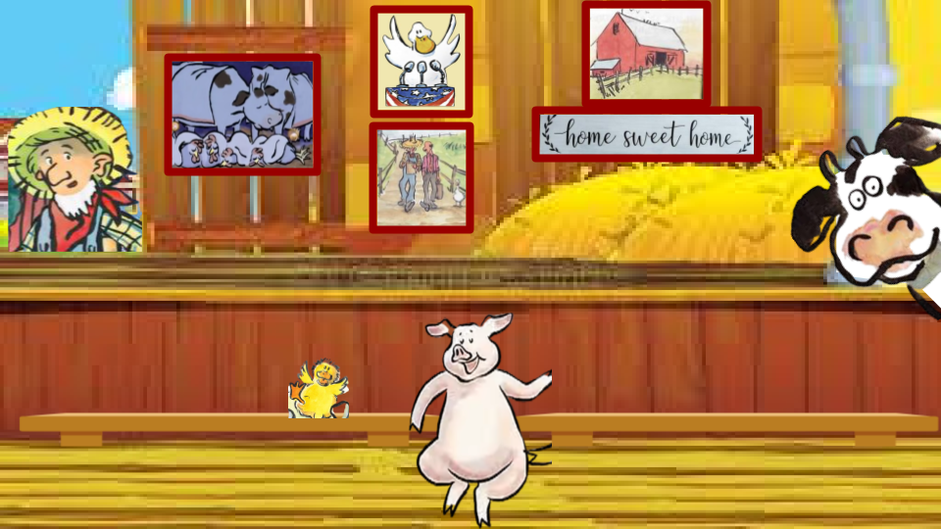

Click on the book

Slide 3
Last time we discussed...
How the animals worked together to solve their problem and how they got the farmer to change his mind?
What other animals might want to improve their living conditions?
What will they do if the farmer does not give it to them?

Slide 4
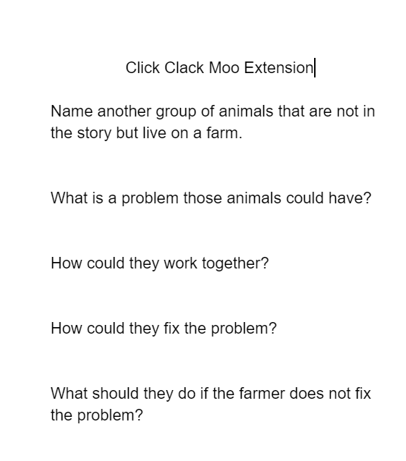
Who else might need help on the farm?
Click on page to write on the document.

Slide 5
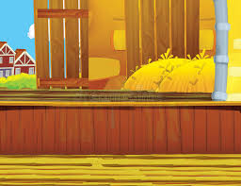
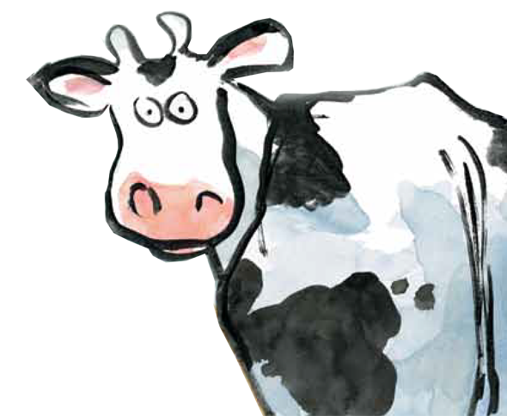

What would you like to change in your community?
Brainstorm a list with your classmates.

Slide 6
Now you decide!
What do you want to change in your community?
Use the graphic organizer on the next part to start planning this out.

Slide 7
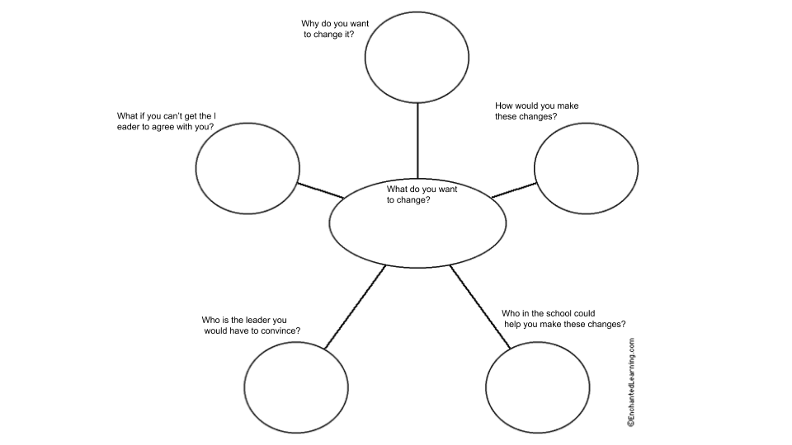
Click here if you are going to type your answers.

Slide 8
Create A Plan
Choose how you want to share your learning. We will start this work next time.

Slide 9
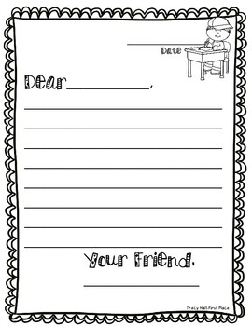
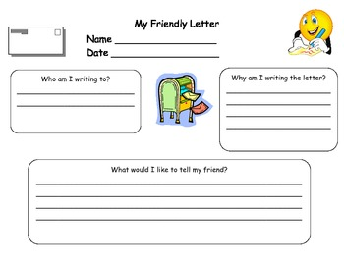
Write a letter to share what you would like to change in your community. If you wanted a new park bench who would you write to? What would you say? How would you convince them?
Click here if you are going to type your letter.

Slide 10
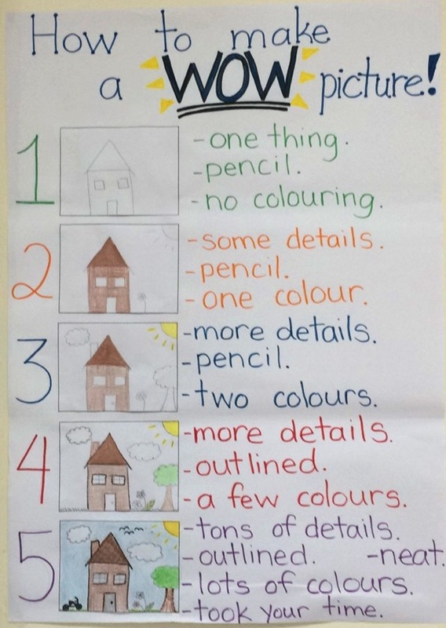
Create a poster
Your poster needs:
-to state what issue you want to change.
-give evidence on your ideas
-steps to make the change

Slide 11
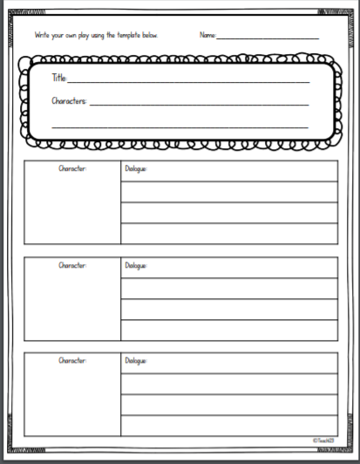
Act it Out
What do you want to change in your community? You are going to write down what people would say as if they were on TV. Decide who is
going to be talking, then write what they will say. This is called a script.
Click here if you are going to type your script.

Slide 12
Let your teacher know what you have chosen for a topic and how you will show what you know.

Slide 13
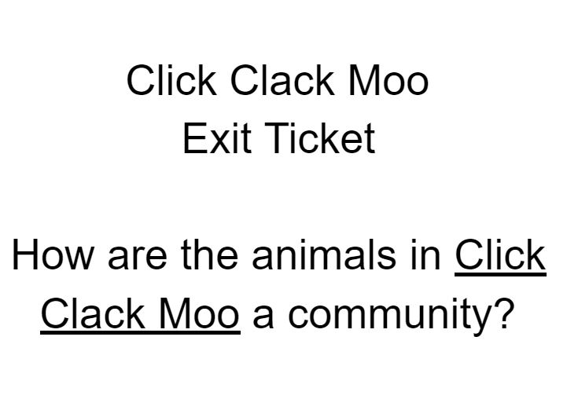
Click on the ticket to pull up the Google Doc

