Slide 1
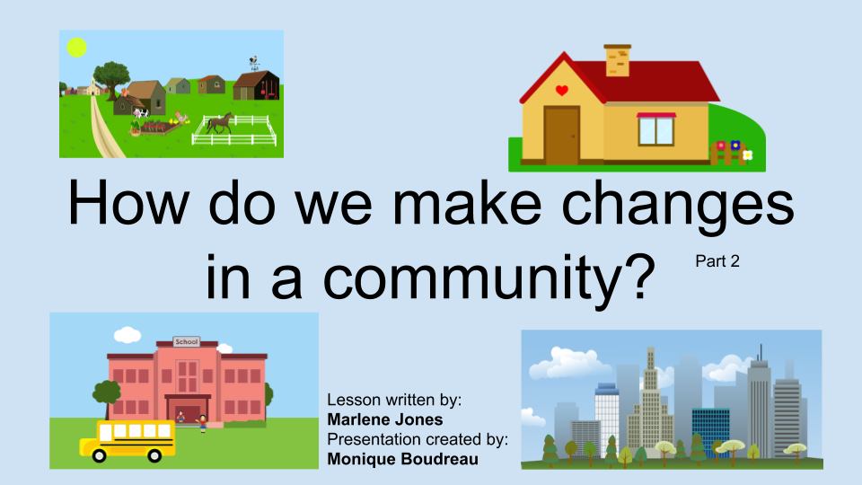
Part 3

Slide 2
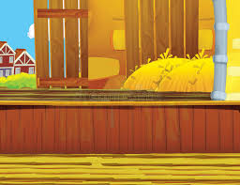


What would you like to change in the community?
Review your work from the last lesson.

Slide 3
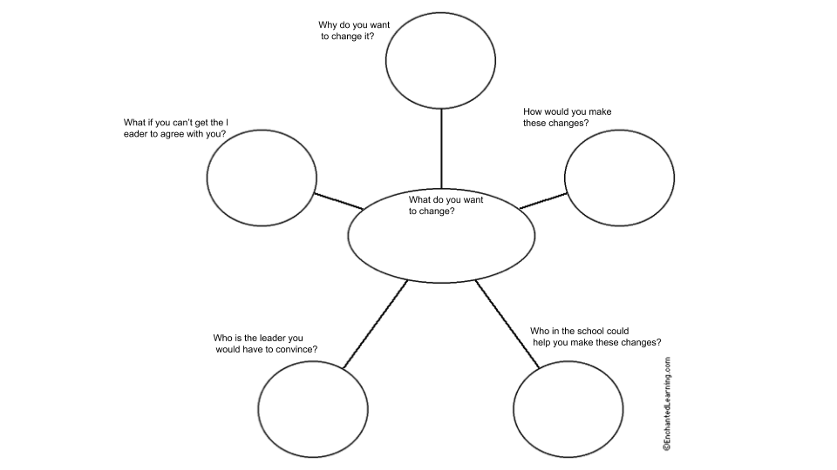
Click here if you are going to type your answers.

Slide 4
Put your plan in action!
Start creating!

Slide 5
Project Options Reminder
Start creating!

Slide 6
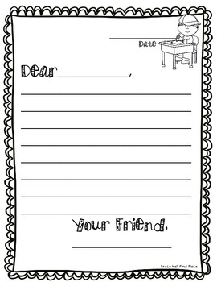
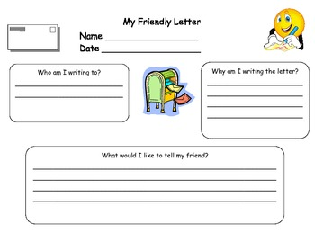
Write a letter to share what you would like to change in your community. If you wanted a new park bench who would you write to?
Click here if you are going to type your letter.

Slide 7
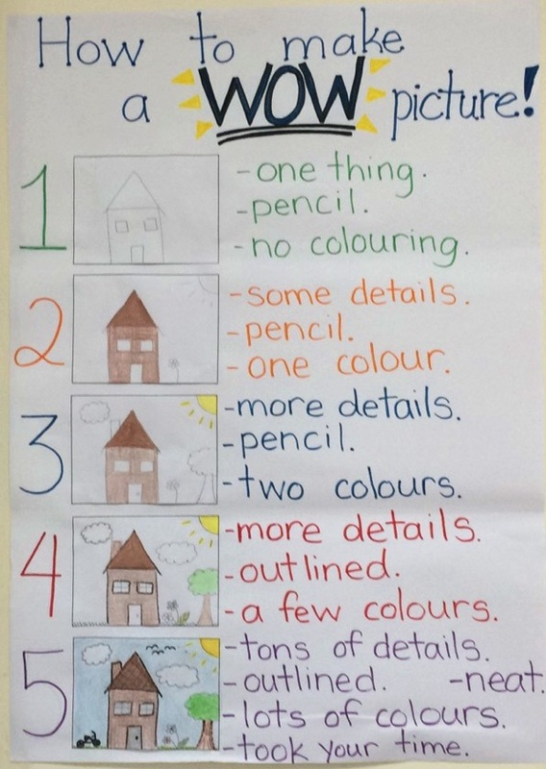
Create a poster
Your poster needs:
-to state what issue you want to change.
-give evidence on your ideas
-steps to make the change

Slide 8
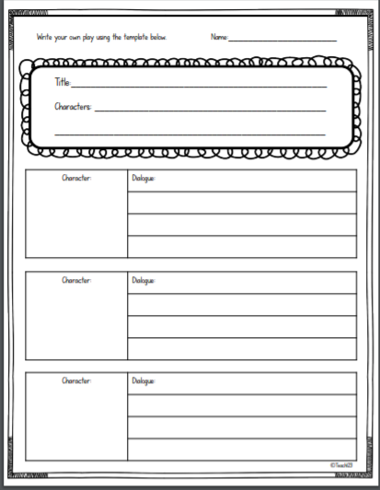
Act it Out
You are going to write down what people would
say if they were on TV. Decide who is
going to be talking, then write what they will say. This is called a script.
Click here if you are going to type your script.

Slide 9
You might need more than one day to do this project. Take your time and do your best work.

