Slide 1
Teacher Notes:
Purpose:
Students will be familiar with the purpose of the Preamble of the U.S. Constitution.
Students will be able to explain some key phrases and define key vocabulary as evidenced by their responses on the exit ticket.
Please click here for the original lesson. Deconstructing the Preamble
This lesson has been adapted for students participating in a remote/hybrid model.

Slide 2
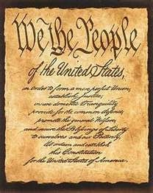
The Preamble to the Constitution

Slide 3
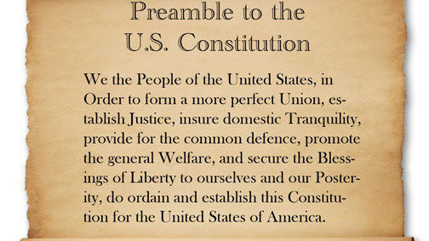

Slide 4
The Preamble to the Constitution introduces the Constitution and sets forth the general purposes for which the government was established. It declares the power of the government comes from the people.

Slide 5
These are the phrases in the Preamble that may be difficult to understand.
perfect union
establish justice
insure domestic tranquility
provide for the common defence
promote the general welfare
secure the blessings of liberty to ourselves and our posterity
Watch the next two videos to help you better understand these phrases.

Slide 6
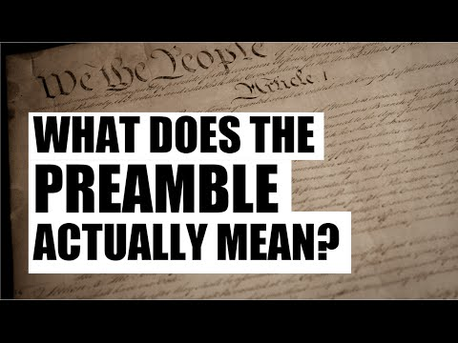

Slide 7
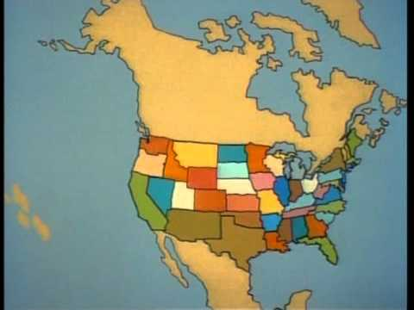

Slide 8
Now it is time to show what you know.
Directions: Read the original line from the Preamble and then put the line in your own words on the right side. You may need to rewatch the video, “ What Does the Preamble Actually Mean? When you are finished, please share with your teacher.
PREAMBLE QUOTE YOUR INTERPRETATION
“In order to form a more perfect union”
“establish justice” Type here
“insure domestic tranquility”
“provide for the common defence”
“promote the general welfare”
“secure the blessings of liberty to ourselves
and our posterity”
“secure the blessings of liberty to
ourselves and our posterity”
Type here
Type here
Type here
Type here
Type here

