Slide 1
Teacher Notes:
Purpose: Students will be able to list the three main Constitutional qualifications for becoming president of the United States as evidenced by accurately completing the comic strip assignment.
Click here for the original lesson.
Qualifications to Run for President
This lesson has been adapted for students participating in a remote/hybrid model.

Slide 2
Today we are going to be learning about the qualifications a person has to have to become President of the United States.
What are qualifications? A qualification is a skill, or quality that makes a person suitable for a job. For example, to be a mechanic a person must be able to perform general maintenance and repairs on automotive vehicles, including on-board computers. Many employers require certificates or an associate’s program in automotive technology.

Slide 3
There are three qualifications a person must have to become President of the United States. What do you think the qualifications to become President are?
1.
2.
3.
CLICK THE BOX TO TYPE YOUR THOUGHTS.

Slide 4

Today we are going to be exploring the qualifications a person has to have to become President of the United States.

Slide 5
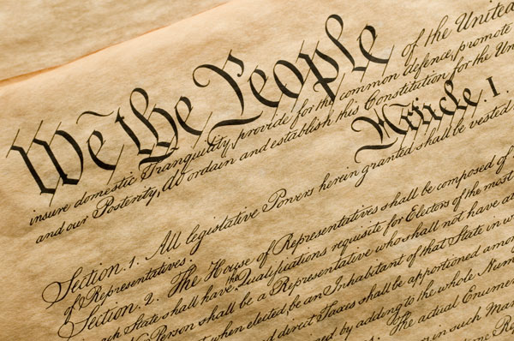
Click here to check out this link! You can read the qualifications right from our Constitution!

Slide 6
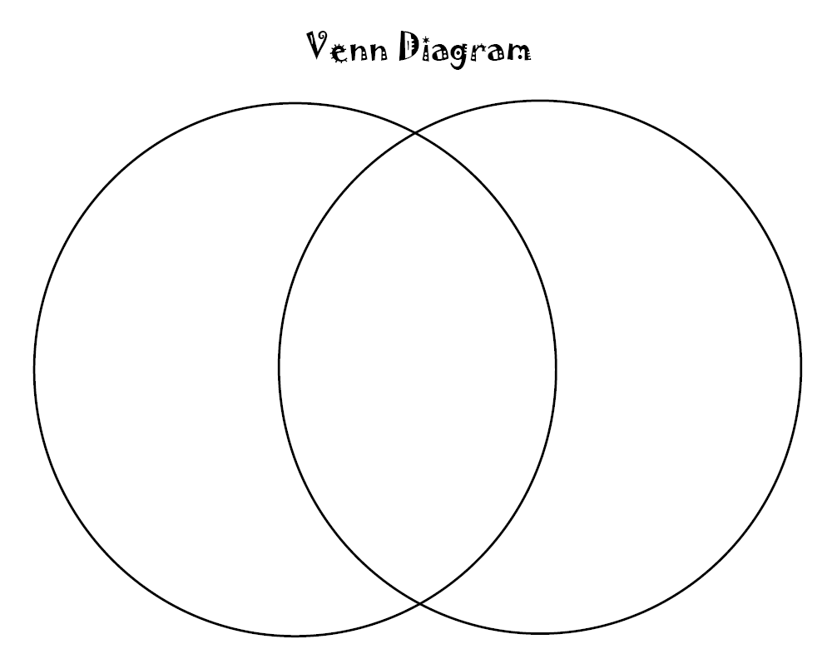
Compare/Contrast the actual qualifications for becoming President to what you predicted on slide 3. Use the Venn Diagram to record your responses.
My Thoughts
Same
Constitution
TYPE HERE
TYPE HERE
TYPE HERE

Slide 7
Now it is time to show what you know!
.
.
.
Name the 3 main qualifications for becoming president. Feel free to add drawings or graphics.
Be sure to hit the yellow share button to send this to your teacher.
CLICK THE BOX.

