Slide 1
Teacher Notes
Purpose:
Students will learn strategies on how to respectfully disagree. Using given templates, students will choose a given topic and create both pro and con arguments for that topic.
Note to Teachers: If possible, students could practice presenting their opposing views to each other in a respectful manner. Students who choose the same topic could be paired up.
Click here for original lesson.
Respectfully Disagreeing
This lesson has been adapted for students participating in a remote/hybrid model.

Slide 2
Respectfully Disagreeing
People disagree. We may disagree on whether or not there should be homework, school uniforms, more recess time, year-round schools, or whether or not students be able to chew gum in school.
Discourse is a written or spoken disagreement. It is important when we disagree, either in writing or speaking, that we are respectful to each other. The article and videos that follow will help you understand what it means to respectfully disagree.

Slide 3
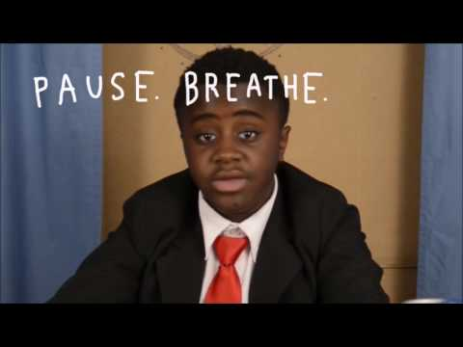

Slide 4
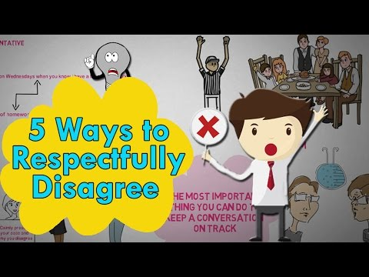

Slide 5
Let’s review the five ways to respectfully disagree.
Don’t make it personal
Avoid putting down the other person’s ideas or beliefs
Use “I” statements
Listen to the other person’s point of view
Stay calm

Slide 6

Click the article below to read, or listen to the article. Pay attention to the steps you can take to create a strong, respectful argument.
Newsela Article

Slide 7
Remember these three parts of an argument with three letters: A R E.
A Assertion: This is a simple statement like:
Students need to spend more time enjoying recess.
R Reasoning: This is the “because” part of an argument:
Students need to spend more time enjoying recess
because fresh air and exercise fosters a healthy body.
E Evidence: This is the part that supports the reasoning:
Students need to spend more time enjoying recess
because fresh air and exercise fosters a healthy body.
Fresh air has been shown to help digest food, strengthen the
immune system,reduce obesity rates, and lead to a healthier
body.

Slide 8
There are four parts to refuting an argument.
Restate: The first step is to restate the argument that you want to challenge.
Speaker one says that students need to spend more time outdoors.
Refute: The next step is to state your opposite point of view, which you can introduce with the word "but".
Speaker one says that students need to spend more time enjoying recess, but that will take away
from academic time.
Support: In this part of a refutation you should give reasoning and evidence to make your claim stronger.
Speaker one says that students need to spend more time enjoying recess, but that will take away
from academic time. Recess takes away from important instructional time which may improve
test scores.
Conclude: In the fourth step you should wrap up your refutation by introducing your final, key point with
a word like “therefore”.
Speaker one says that students need to spend more time enjoying recess, but that will take away
from academic time. Recess takes away from important instructional time which may improve
test scores. Therefore, students should not spend more time enjoying recess.

Slide 9

Now it is time for you to give it a try!
Your task is to use what you have learned to create an argument for and against one of the topics on the next slide. You will need to do some research to support your position on both sides of the argument.

Slide 10
Here are a few topics to choose from….
Junk food should be banned from schools
Zoos should be abolished.
Sports stars are paid too much money
Recycling should be required
Homework should be banned

Slide 11
Use this slide to type your assertion, or simple statement.
A Assertion:
R Reasoning:
E Evidence:
TYPE HERE
TYPE HERE
TYPE HERE

Slide 12
Use this slide to type your argument against the simple statement.
Restate:
Refute:
Support:
Conclude:
TYPE HERE
TYPE HERE
TYPE HERE
TYPE HERE

