Slide 1
Rights of a Citizen
Adopted for remote learning by Corey Genest

Slide 2
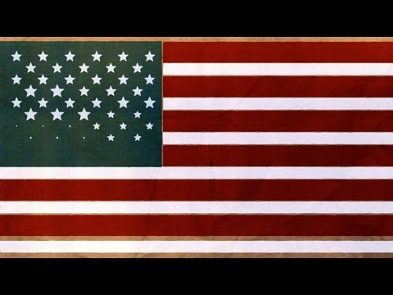
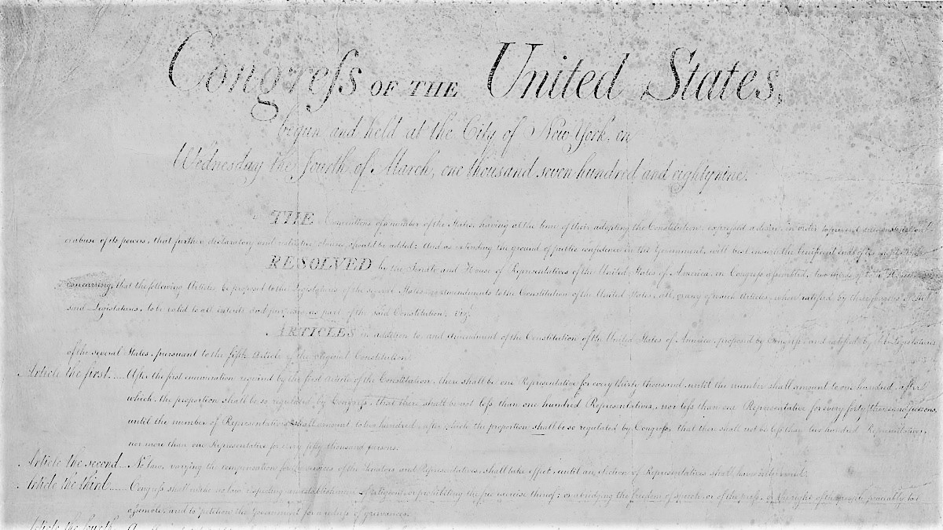
Understanding the Bill of Rights
Please view this 3-minute guide to the Bill of Rights.

Slide 3
Which matter most?
(to you)
Ten fundamental rights that our government, long ago, deemed essential to our liberty.
For this assignment, you are asked to review in greater detail the significance behind each of the first ten amendments to the Constitution. After that independent study, it is your job to create three political cartoons that highlight the significance of three of the amendments. Ideally, you will select the three amendments that you deem to be the most important to your life. Use these two resources to assist you:
The Bill of Rights - Cornell’s law database. This will give you text and analysis of the Bill of Rights.
Political Cartoons - Also Cornell. This is a great place to start exploring political cartoons to prime your creative pump.

Slide 4
The assignment
(what to do)
Once you have created your political cartoons, you will need to create a digital file format that you can upload to this file. On each of the following three slides, you will submit one cartoon and then provide a one paragraph explanation of the amendment you selected and how the cartoon corresponds to that particular right and why it is essential to liberty.

Slide 5
[upload your cartoon here]
Cartoon 1
[type your explanation here]

Slide 6
[upload your cartoon here]
Cartoon 2
[type your explanation here]

Slide 7
[upload your cartoon here]
Cartoon 3
[type your explanation here]

