Slide 1
Teacher Notes
Purpose:
Students will be able to indicate the difference between a “rule” and a “law” and provide one example for each as evidenced by completion of the exit ticket.
Click here for original lesson.
Rules and Laws
This lesson has been adapted for students participating in a remote/hybrid model.

Slide 2
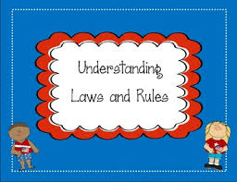
Rules are codes that guide behavior at the level of families, organizations and communities to keep people safe. Laws are rules that are proposed by and voted upon by the government. Everyone must obey laws.
Today we will learn the difference between a “rule” and a “law”!

Slide 3
Here are some things to think about as you watch the next slide.
A community is a group of people who live and work together. Your neighborhood, town, city, and school are communities. Communities create rules to keep people safe. LIsten for examples of rules in communities.
Government leaders make rules for everyone to follow in a community to keep people safe. These rules are called laws. LIsten for examples of laws in communities.
Listen for ways that citizens can work to change laws in communities.

Slide 4


Slide 5
What did you learn? You may want to watch the video a second time before answering the questions.
Name 2 or more rules a community may have to keep citizens safe.
Name 2 or more laws a community may have to keep citizens safe.
How can a citizen work to change a law?
TYPE HERE
TYPE HERE
TYPE HERE

Slide 6
CLICK AND DRAG UNDER THE CORRECT HEADING
RULES
LAWS
Wear a seatbelt in the car
Use your quiet voice
Raise your hand to ask a question
Drive the speed limit
Stop at red lights
Walk in a crosswalk
Listen to the teacher
Use walking feet

