Slide 1
Separation of Powers and the Debt Ceiling
Adapted from “Money, Democracy and the Constitution” by Chris Herr and Tristan Black-Ingersoll; unit one
Adopted for remote learning by Corey Genest

Slide 2
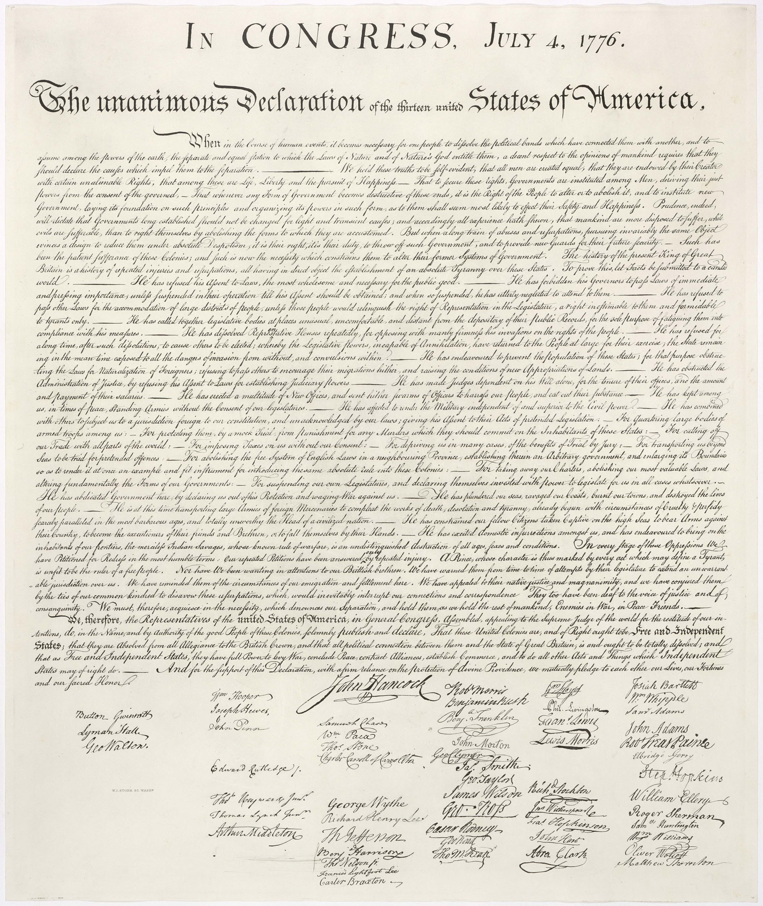
“Good Governance”
When you are ready, please click the image of the Declaration of Independence on the right. It will direct you to the National Archives. Please read the Declaration upon arrival. Afterward, review the questions that appear on the following slides and provide answers to them.
As you read, look for the complaints that the Founders had.

Slide 3
What were the biggest concerns for the Founders? What trends emerged in the complaints?
[type answer here]

Slide 4
What solutions seem to appear more than once? What does that tell you about the Founders’ views on good governance?
[type answer here]

Slide 5
Describe the Founders ideal government based on the complaints contained in the Declaration.
[type answer here]

Slide 6
How does your view of good governance compare to that of the Founders? How were they similar and/or different?
[type answer here]

Slide 7
Power
vs
Authority
A straightforward way of differing between power and authority is that power describes one’s ability to do something while authority describes one’s permissibility to undertake an action. In other words, just because you can do something does not mean that you should. An abuse of power occurs when one’s actions exceed the authority they have been granted.
What is the difference?

Slide 8
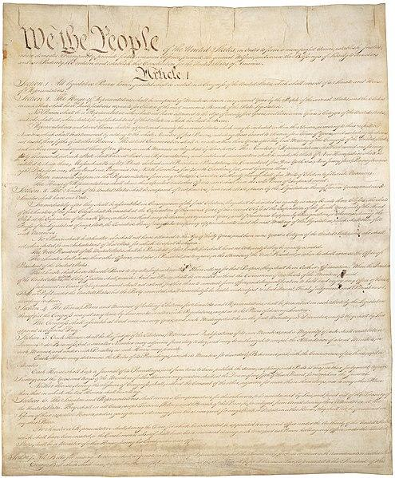
Power and Authority in the Constitution
Read the Constitution (link is the image)
On the following slides, create a graphic organizer identifying the powers and limitations of each branch of government.
Identify where the power or limitation is located (i.e. Article I, Section I).

Slide 9
Article I - Legislative Branch
Powers of the Branch
Source of Power (Article, Section)
[type powers here in bulleted format]
[cite the source here, in bulleted format]

Slide 10
Article II - Executive Branch
Powers of the Branch
Source of Power (Article, Section)
[type powers here in bulleted format]
[cite the source here, in bulleted format]

Slide 11
Article III - Judicial Branch
Powers of the Branch
Source of Power (Article, Section)
[type powers here in bulleted format]
[cite the source here, in bulleted format]

Slide 12
Tying it all together...
How do the Founders’ complaints contained in the Declaration of Independence connect to the separation of powers in the US Constitution?
[type your answer here]

Slide 13
The Debt Ceiling
What is the debt ceiling and what are the consequences if the United States defaults?

Slide 14
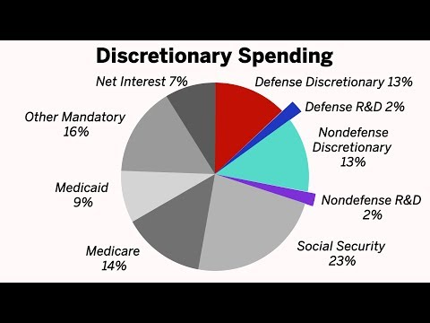
The Budget Process
How do Congress and the President determine spending?
Important:
While Congress controls the purse, the President maintains significant discretion in deciding how allocated funds are spent.

Slide 15
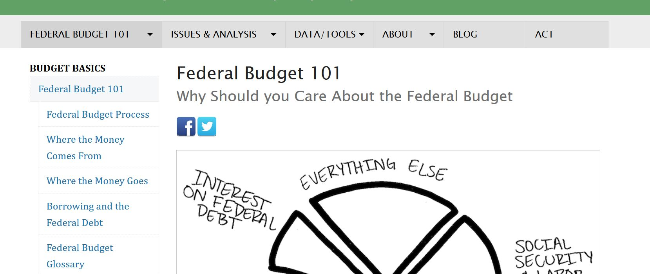
Understanding the Federal Budget Process
Please visit this resource - Federal Budget 101 - to educate yourself on how the federal budget process works. There are five tabs to read through starting with “Federal Budget 101” and concluding with “Borrowing and the Federal Debt” (as seen below). Afterward, please answer the questions on the next slide.

Slide 16
Should the federal government be allowed to spend more money than it collects? Why or why not? Would you change anything about the budget process and/or the spending, taxing and borrowing powers delegated to Congress and/or the President? Why or why not?
[please enter your answers here]

Slide 17
The Debt Ceiling
Absolutely everything you need to know…
What is the debt ceiling?
A Wall Street Journal video summary
Please take some time to review the resources on this page and then answer the questions on the following pages.

Slide 18
What is the debt ceiling and why was it created?
Why has it become more of a national issue in the last few years?
How does the debt ceiling connect to the Constitution?
[enter your answer here]
[enter your answer here]
[enter your answer here]

Slide 19
Defaulting on the debt
What happens when a country goes bust?
Nightmare Scenario
What happens in a US debt default?
Please take some time to review the resources on this page and then answer the questions on the following pages.

Slide 20
What does it mean to default?
How does the government default on its debt?
What are the short term consequences of defaulting?
[enter your answer here]
[enter your answer here]
[enter your answer here]

Slide 21
Should the government be allowed to default on its debt, or should the government be forced to continue borrowing if possible to pay for debts it has already incurred? Explain your response.
[enter your answer here]

Slide 22
Constitutionality
Does the President have the constitutional authority under Section 4 of the Fourteenth Amendment to continue borrowing money in excess of the debt ceiling in order to avoid default?

Slide 23
Let’s check the 14th Amendment
14th Amendment to the Constitution
Paying close attention to section 4, please read this amendment to the Constitution.
Think about this question:
Does the 14th Amendment force the US government to pay all its debts?

Slide 24
A history lesson.
The legislative history of section 4 - Jack Balkin, Professor of Law, Yale
After you read this post, please answer the question on the following slide.

Slide 25
After reviewing the 14th Amendment and Professor Balkin’s essay how do you answer the question “Does the 14th Amendment force the US government to pay all of its debts?”
[type your answer here]

Slide 26
A case study.
Perry v United States
Oyez.org summary
Perry v United States
After studying the SCOTUS case and decision, please answer the two questions on the next slide.

Slide 27
Would Congress violate the Constitution by refusing to raise the debt ceiling and allowing the US to default on its debt?
[type your answer here]
If that happens, can the President step in and continue to borrow money in order to uphold Section 4 of the Fourteenth Amendment, or would this action violate the Constitutional principle of separation of powers?
[type your answer here]

Slide 28
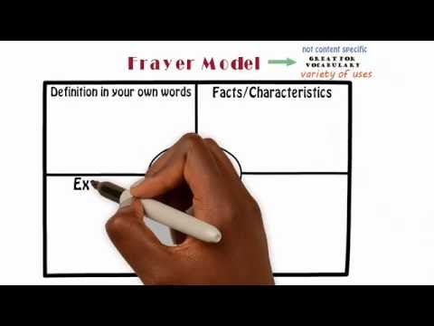
On the following slides, please complete the Frayer models to help with your understanding of the definitions of necessary and Constitutional.
To the right is a short video that explains how to create a Frayer model if you are unsure how to do so.

Slide 29
[type here]
[type here]
Definition
Characteristics
Necessary
Examples
Non-examples
[type here]
[type here]

Slide 30
[type here]
[type here]
Definition
Characteristics
Constitutional
Examples
Non-examples
[type here]
[type here]

Slide 31
Based on the definitions you developed, should elected officials violate the Constitution if they believe it is necessary? Why or why not?
[type your answer here]

Slide 32
Checking in with Thomas Jefferson
Jefferson’s Letter to Colvin
Please read Jefferson’s letter to John Colvin. Afterward, answer this question: Did Jefferson believe that presidents should violate the Constitution when necessary? Why or why not?
[type answer here]

