Slide 1
Student’s First Amendment Rights in Schools
What is the relationship between free expression in schools and limits on free speech?
Adopted for remote learning by Corey Genest

Slide 2
Question:
Should students enjoy the same speech liberties as citizens in the public sphere?

Slide 3
Question:
Correspond with a classmate and share your opinions with each other. Afterward, provide a brief summary of your discussion to your teacher.
Should students enjoy the same speech liberties as citizens in the public sphere?

Slide 4
Oyez, oyez, oyez.
The question of what constitutes free and appropriate speech in a school and what may be deemed inappropriate or disruptive speech in a school is not clearly answered. Nonetheless, the Supreme Court of the United States has heard many cases regarding student rights to free speech and has in fact placed restrictions. The following landmark cases all involve free speech in schools. Please use the short videos to familiarize yourself with each case. Note that the full opinion of the Court and a summary of the Court’s ruling can be found accompanying each video.

Slide 5

The opinion
Summary

Slide 6
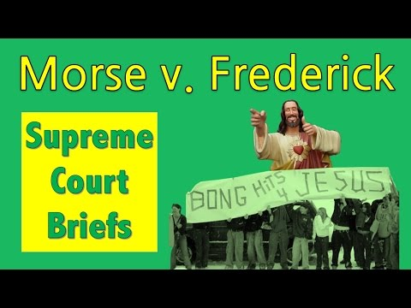
The opinion
Summary

Slide 7
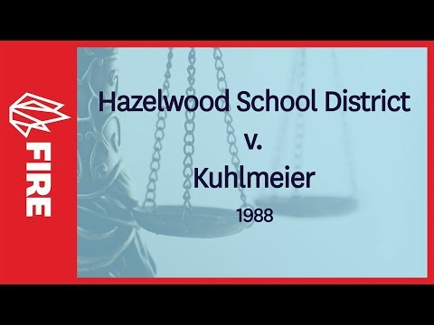
The opinion
Summary

Slide 8
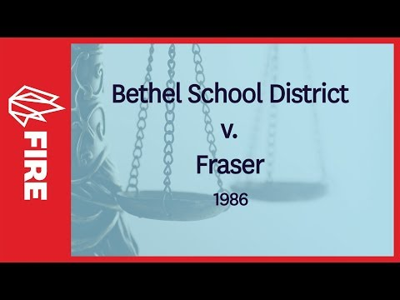
The opinion
Summary

Slide 9
Question
Take a moment to review your student handbook. Consider policies about bullying, social media usage, and language and conduct in school and determine if they are constitutional.
Do your school’s policies regarding speech and conduct align with SCOTUS precedent?

Slide 10
Group or Individual Assignment
Option A: Position paper
Write a position paper arguing for or against a school or district policy. Use case law to support your position and submit your paper to the school board and/or local government.
Option B: iMovie Documentary
Create a short video presenting the historical perspective and/or the civic imperative of a particular policy. What are the arguments for expanding or narrowing the scope of the First Amendment in schools?

