Slide 1
Teacher Notes:
Purpose: Given background knowledge on Veteran’s Day and who veterans are, students will be able to give at least two reasons why veterans are so important.
Click here for the original lesson.
Thank a Veteran
This lesson has been adapted for students participating in a remote/hybrid model.

Slide 2
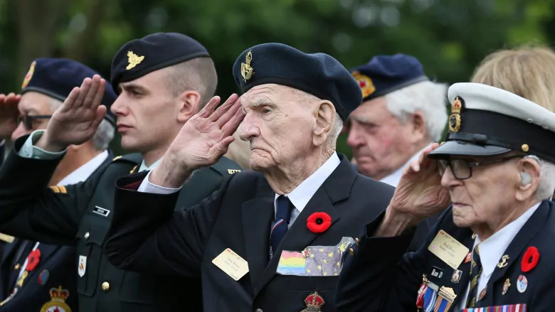
What is a Veteran?

Slide 3
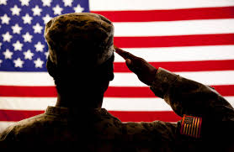
A veteran is a former member of the armed services or military. Branches of the military include the Army, Navy, Air Force, Marine Corps and Coast Guard. Veterans may have served during times of war or peace.
CLICK HERE TO LISTEN

Slide 4
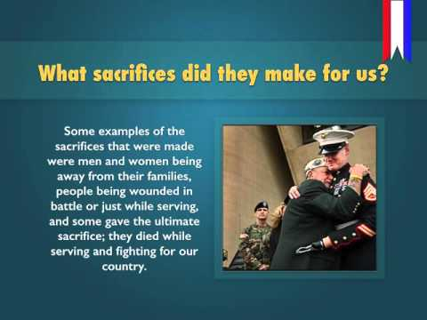
What is Veteran’s Day?

Slide 5
Do you know a veteran?
Ask an adult in your home if one of your family members is a veteran, or if your family knows a veteran. Maybe you have a neighbor who is a veteran. If you are able, your task is to interview a veteran so that you can share the interview with the class during a Zoom meeting. Be sure to thank your veteran for her/his service to our country.
Here are a few questions you can ask your veteran.
What was your branch of service? What was your job and when did you serve?
What was the hardest part of your job?
What was the most rewarding part of your job?
TYPE HERE
TYPE HERE
TYPE HERE

Slide 6

This story helps in understanding what it means to honor those who have given their lives for our freedom.

Slide 7
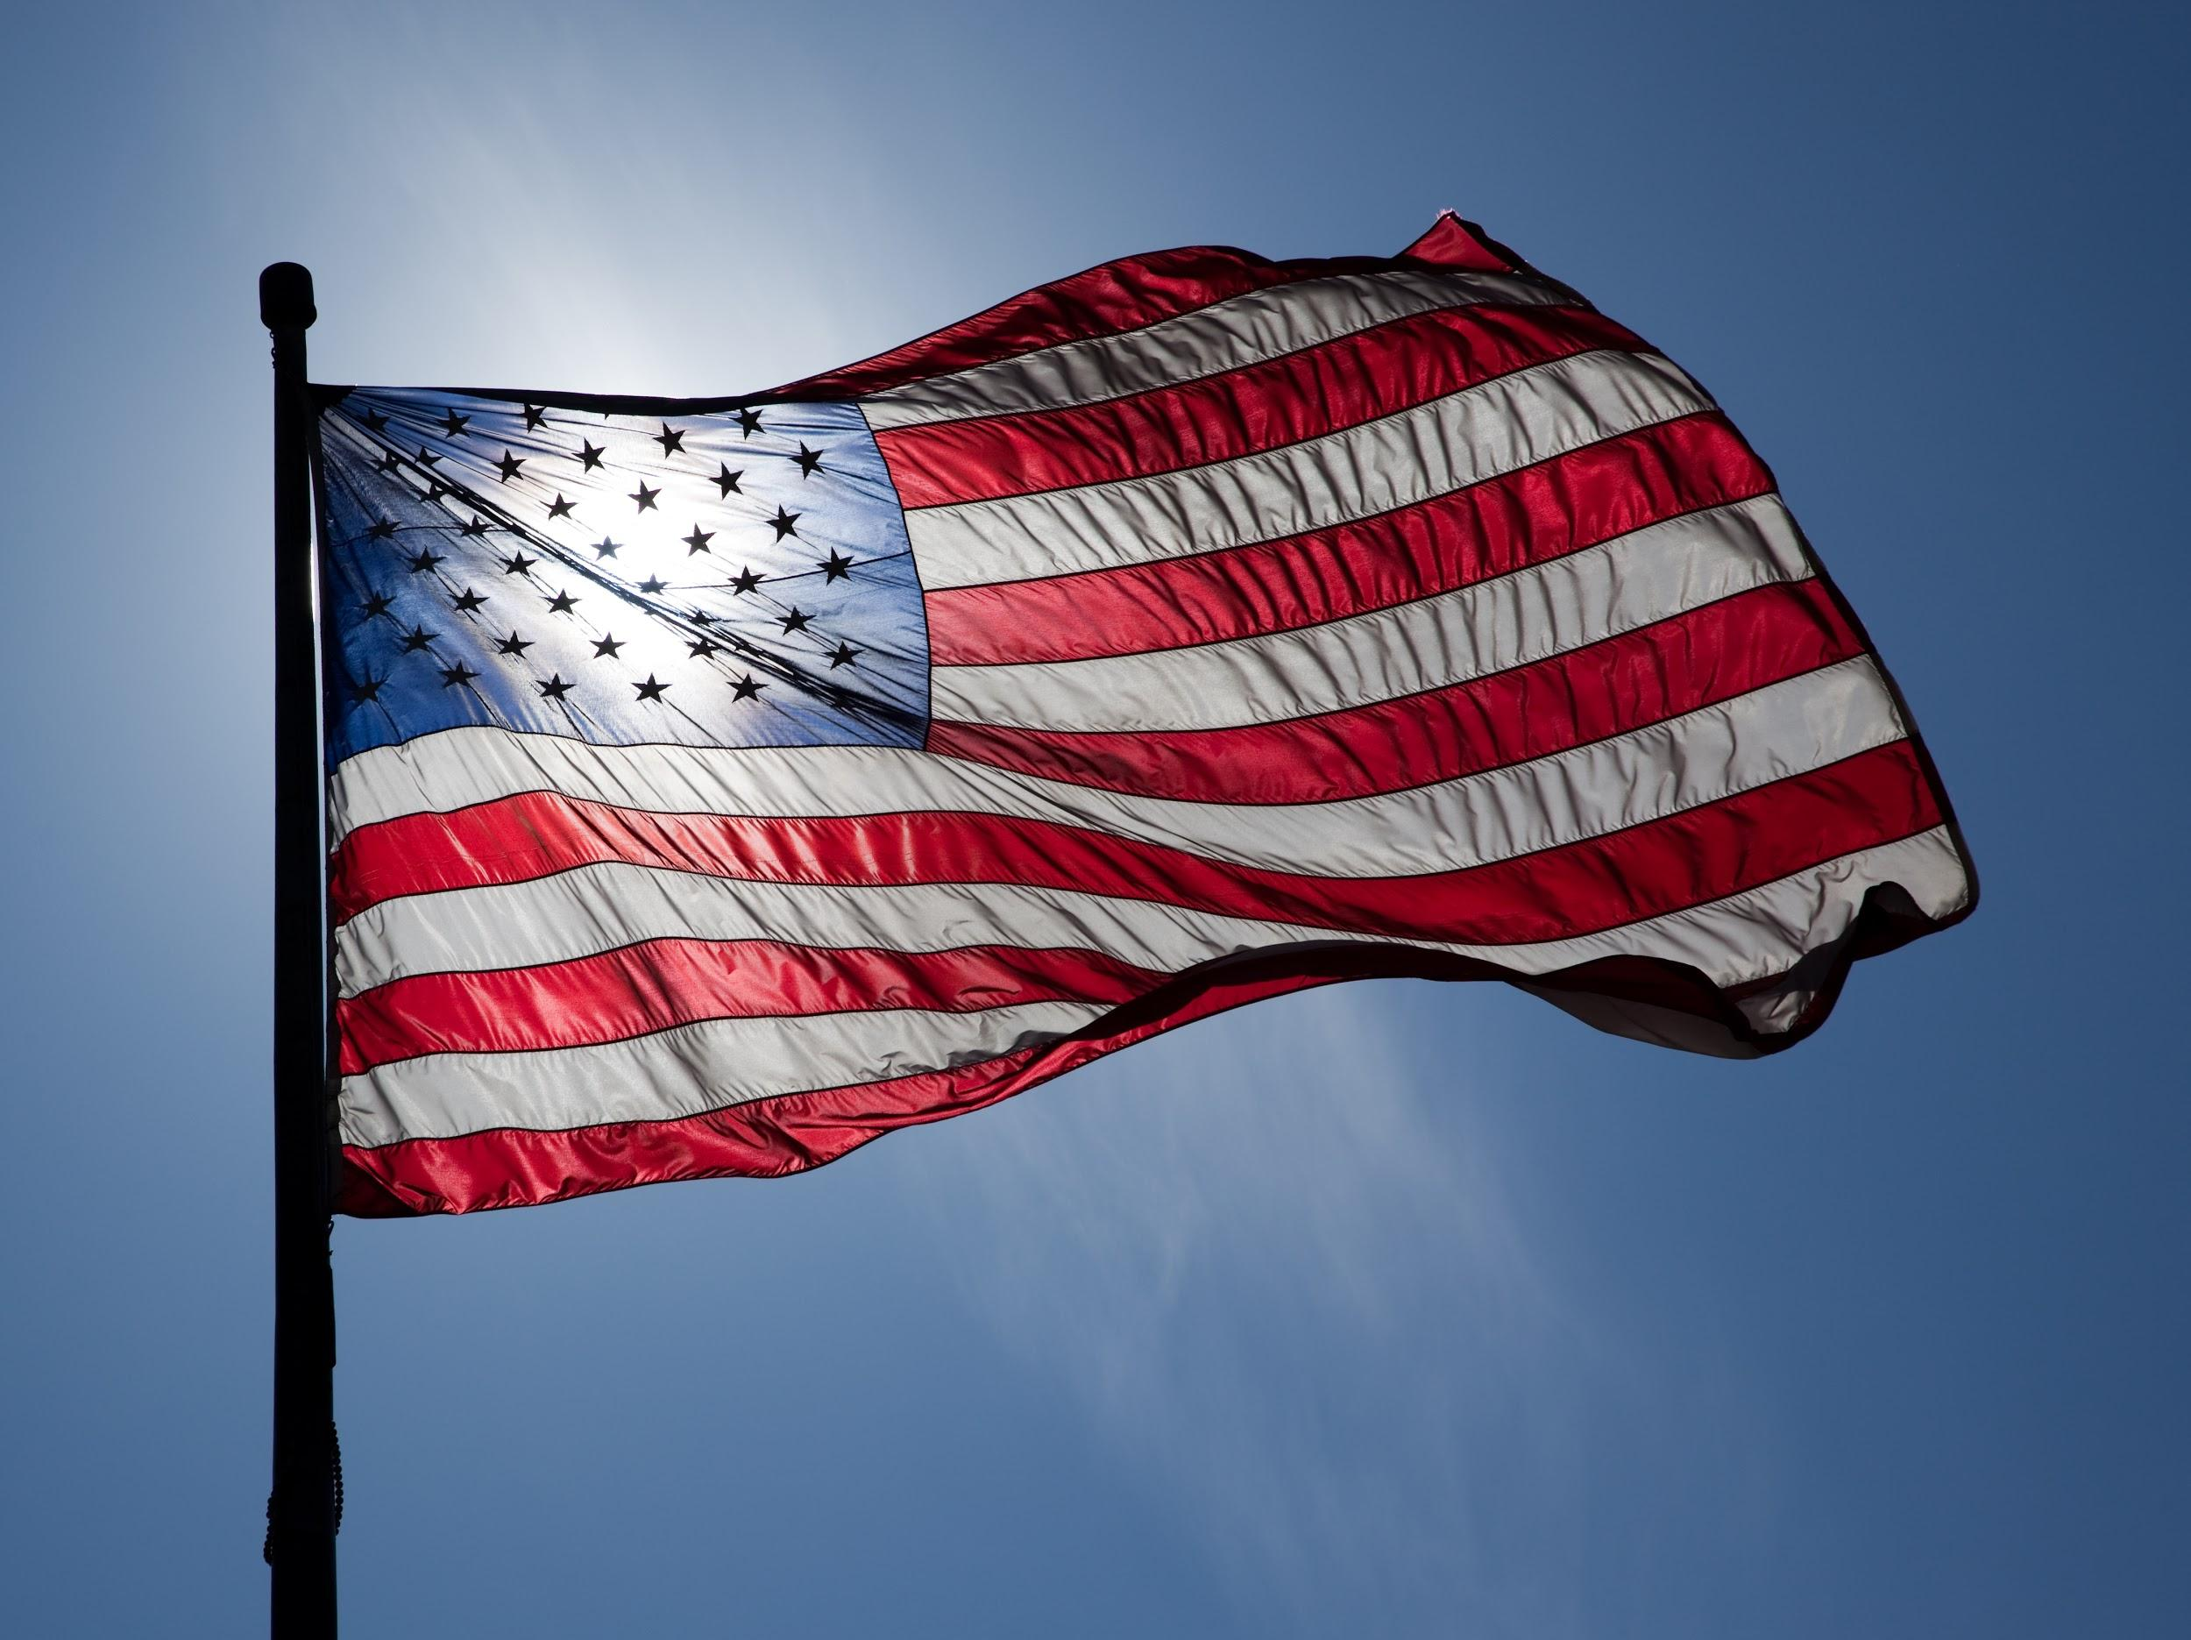
We have learned a lot about veterans and Veteran’s Day today!
Please type two, or three things you have learned today.
TYPE HERE
TYPE HERE
TYPE HERE

