Slide 1
Teacher Notes:
Purpose:Students will be able to demonstrate understanding and communicate the meanings of the 10 Amendments of the Bill of Rights. They will be able to identify the rights that mean the most to them. They will be able to connect the relevance of the amendments in connection with their own lives
Click here for the original lesson.
Bill of Rights
This lesson has been adapted for students participating in a remote/hybrid model.

Slide 2
The Bill of Rights
Today you will learn about the Bill of Rights. The Bill of Rights is the first ten amendments to the United States Constitution.
In 1787, at the Constitutional Convention, men created a document that governs our country. In order for the Constitution to take effect, it had to be approved by 9 of the 13 states. Many states were not ready to approve the document because they didn’t think it guaranteed basic freedoms and rights to Americans. They worried that too much control was given to the federal government.
So, James Madison, known as the Father of the Constitution, wrote 12 amendments. He presented them to Congress in 1789 and they approved 10 of them. Let’s move on to learn more about The Bill of Rights!

Slide 3
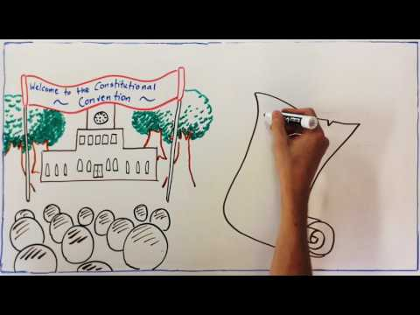
This really cool video reviews the United States Constitution through the hand of an artist!

Slide 4
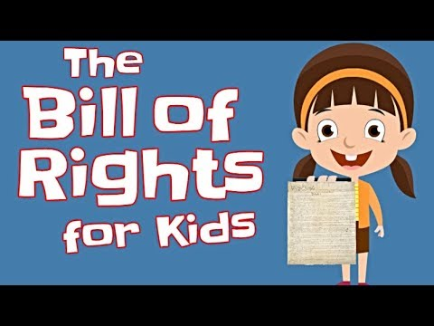
BEGIN VIDEO AT :45

Slide 5
A Guide to the First Ten Amendments to the Constitution
The Bill of Rights
1st
This means that people are allowed to express their opinions through speech and news and media. It protects the right to gather in a group to protest peacefully or for other reasons. People can practice any religion they choose.
The 1st Amendment grants freedom of speech, freedom of press, freedom of assembly, and the right to protest.

Slide 6
2nd
This means that citizens can own weapons to hunt or to protect themselves.
The 2nd Amendment grants the right to bear arms.
3rd
Before the Revolution, the British military would force Americans to provide food and housing for their soldiers. The 3rd Amendment says that in war or peacetime, American citizens will never have to house soldiers in their homes without giving permission.
The 3rd Amendment states that soldiers cannot take over a home during war or peace.
4th
The 4th Amendment protects Americans from unreasonable and unlawful search and seizure of property.
This means that law enforcement must have a good reason to search and seize a citizen’s property.
A search warrant, signed by a judge, is required.

Slide 7
5th
This means that anyone accused of a crime is provided rights and assumed innocent until proven guilty. A person cannot be tried twice for the same crime. Also, a person cannot be forced to testify against himself.
The fifth amendment allows all citizens due process. A person cannot be forced to serve as a witness against himself when accused of a crime.
6th
This means a citizen has a right to a speedy and public trial by an impartial (fair) jury. The defendant has the right to a lawyer and to bring their own witnesses to the trial.
The 6th amendment provides a speedy and public trial by jury for all who are accused of a crime.
7th
This means that certain civil cases may also be tried by a jury.
The 7th amendment allows for
a trial by jury to be held for certain civil disputes.

Slide 8
8th
This means that citizens are protected from having to pay unreasonably high bail in order to be released from jail while they wait for trial. It is also against the law for citizens to receive “cruel and unusual punishment” for crimes.
The 8th amendment prevents those accused of suffering cruel and unusual punishment.
9th
This means that people’s rights are not limited only to rights that appear in the Constitution. This amendment can be confusing because the rights are not listed. Some people think state legislatures should decide and some think the Supreme Court should decide.
The 9th amendment states that no one’s Constitutional rights should be used to infringe upon the rights of another citizen.
10th
This means that the federal government only has the powers mentioned in the Constitution. If not listed, it belongs to the states or to the people.
The 10th amendment provides each state with powers that are not specifically assigned to the nation’s government in the Constitution.

Slide 9
It is time to show what you know!
What have you learned about the Bill of Rights, the first ten amendments to our Constitution?
Directions: Read each scenario. Which amendment of the US constitution is involved with each scenario? Explain why you chose that amendment. Use the text box to type your answer and then share your finished work with your teacher.
SCENARIOS
The army base in your town is over-crowded. The town council passed a law that anyone with an extra bedroom must house a soldier from the base.
The city is closing the local basketball courts to make way for a parking lot. Dan and his friends want to march to city hall to present a petition to the mayor to keep the courts .
TYPE HERE
TYPE HERE

Slide 10
Sally thinks Betty has stolen her gold bracelet. She wants the police to go to Betty’s house and look around to see if her bracelet is there.
TYPE HERE
Bob Williams has been accused of stealing a computer from his school. He has been in jail for three years waiting for his trial to begin.
TYPE HERE
Every morning during the announcements Clyde refused to say “The Pledge of Allegiance” because it contains a phrase that says “under God.” This statement goes against his beliefs.
TYPE HERE
Marie has written a Letter to the Editor of the town’s newspaper in support of the new traffic laws. The editor will not print her letter as he does not agree with the new laws.
TYPE HERE

