Slide 1
The Fourteenth Amendment and Marriage Equality
Authors: Chris Herr and Tristan Black-Ingersoll
Adopted for remote learning by Corey Genest

Slide 2
What was the origin and purpose of the 14th Amendment?

Slide 3
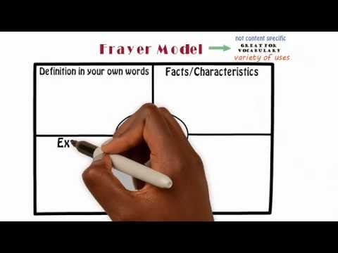
Equality
On the following slide, please complete the Frayer model to help with your understanding of the definition of equality.
To the right is a short video that explains how to create a Frayer model if you are unsure how to do so.

Slide 4
[type here]
[type here]
Definition
Characteristics
equality
Examples
Non-examples
[type here]
[type here]

Slide 5
Have you ever felt that you have be subjected to unequal treatment, like being denied something that was given to somebody else? Explain.
Do you believe that the Constitution protects you from this inequality?
[please enter answer here]

Slide 6
13th Amendment Section 1. Neither slavery nor involuntary servitude, except as a punishment for crime whereof the party shall have been duly convicted, shall exist within the United States, or any place subject to their jurisdiction. Section 2. Congress shall have power to enforce this article by appropriate legislation.
Did the 13th Amendment grant freed slaves citizenship?

Slide 7
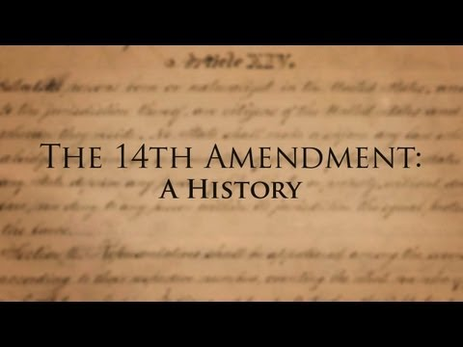
A History of the 14th Amendment
Please view this video on the right about the historical origins of the 14th Amendment. Afterward, please visit this link to read the 14th Amendment in its (brief) entirety.

Slide 8
What potential problems caused by the Thirteenth Amendment may have been solved by the Fourteenth Amendment?
[please enter your answer here]

Slide 9
Please select one of the following scenarios. In the space beneath explain if the law violates the 14th amendment. Be specific.
Law:All parents must complete thirty hours of driving practice under direct supervision of a highway patrol officer in order to earn and keep their driving license. Law:Persons lesser in height than five feet and six inches are required to wear a reflective vest when crossing the street. Law:All sick people are required to wear gloves and masks in grocery stores.
[enter answer here]

Slide 10
Please watch the videos linked at the right
Short videos about the 14th...

Slide 11
Was your interpretation and application of the Fourteenth Amendment accurate? Why or why not?
[enter your answer here]

Slide 12
How and why did the Supreme Court’s application of the Fourteenth Amendment to racial discrimination in schools change over time?

Slide 13
SCOTUS and the 14th
Plessy vs Ferguson
Plessy vs Ferguson (summary)
Brown v Board of Education
Brown v Board of Education (summary)
Please read and study the two landmark supreme court cases on the right. Afterward, use your notes and understanding of the two cases to answer the questions on the slides that follow.

Slide 14
Plessy vs Ferguson
What were the facts of the case?
[enter answer here]
How did the Supreme Court interpret and apply the Fourteenth Amendment?
[enter answer here]
What evidence did the Court rely on in making its decision?
[enter answer here]
Why do you think the Court’s interpretation of the Fourteenth Amendment changed between 1896 and 1954?
[enter answer here]

Slide 15
Brown vs Board
What were the facts of the case?
[enter answer here]
How did the Supreme Court interpret and apply the Fourteenth Amendment?
[enter answer here]
What evidence did the Court rely on in making its decision?
[enter answer here]
Why do you think the Court’s interpretation of the Fourteenth Amendment changed between 1896 and 1954?
[enter answer here]

Slide 16
Does the Fourteenth Amendment protect marriage equality?

Slide 17
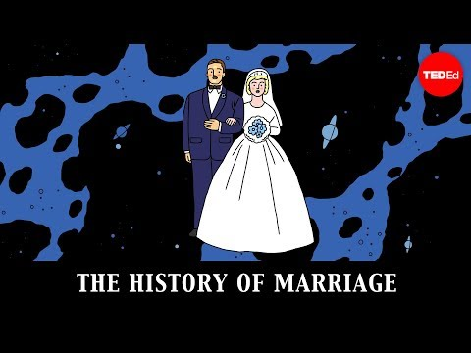
Live Science - History of Marriage
The Week - The Origins of Marriage
Please read the two articles linked above and also watch the short Ted video on the right.
Afterward, please answer the question on the next slide.

Slide 18
Is the history of marriage what you expected it to be? Why or why not?
[enter your answer here]

Slide 19
Legal Benefits of Marriage
(link)
[enter your answer here]
Do the benefits of marriage appear to be something that ought to be subject to the protections of the Fourteenth Amendment’s Equal Protection Clause? Why or why not?
After reading the article linked above, please answer this question in the box on the right.

Slide 20
SCOTUS, the 14th, and Marriage
Please review the Supreme Court decisions listed on the right hand side of this page. Pay attention to how the SCOTUS has reconsidered the meaning of the 14th Amendment over time. Also, keep in mind the impact it has had on marriage. Afterward, please answer the questions on the following slides.
Loving v. Virginia (1967)
Romer v. Evans (1995)
United States v. Windsor (2013)
Obergefell v. Hodges (2015)
As you read, think about the following:
What are the facts of the case?
How did the Supreme Court interpret and apply the Fourteenth Amendment to the facts of the case?

Slide 21
How has the Supreme Court’s interpretation of the Fourteenth Amendment changed over time?
Is there any connection between the change in Americans’ attitudes towards marriage equality and the Supreme Court’s interpretation of the Fourteenth Amendment? Why or why not?
[enter your answer here]
[enter your answer here]

