Slide 1
Teacher Notes:
Purpose: Students will be able to identify the Three Branches of Government as evidenced in the exit slip.
Click here for the original lesson.
Three Branches of Government
This lesson has been adapted for students participating in a remote/hybrid model.

Slide 2
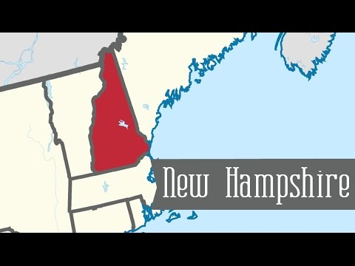
Let’s learn a little bit about our great state!

Slide 3

A Virtual Tour of The New Hampshire State House with
Virginia Drew, Director, NH State House Visitor Center

Slide 4
NEW HAMPSHIRE’S THREE BRANCHES OF STATE GOVERNMENT
EXECUTIVE BRANCH
LEGISLATIVE BRANCH
JUDICIAL BRANCH

Slide 5
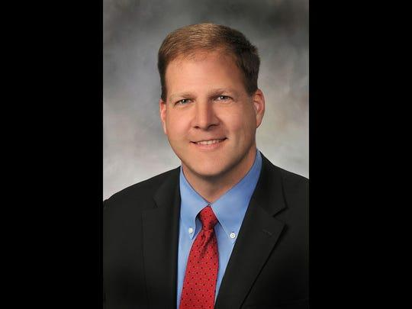
THE EXECUTIVE BRANCH
Governor Christopher Sununu
The Executive Branch in New Hampshire state government is
made up of the Governor, the Executive Council, and state agencies. The Executive Branch enforces the laws in New Hampshire.

Slide 6

The Governor is the supreme executive for the state. The Executive Council has five members who advise the Governor and make sure that he or she does not become too powerful. The Governor and Executive Council are elected every two years.
L-R: Councilors Michael J. Cryans, Andru Volinsky, Russell Prescott, Theodore L. Gatsas and Debora B. Pignatelli

Slide 7
An important part of the Executive Branch are State Agencies. State Agencies are responsible for
public health, safety, education, the environment, and economic development in New Hampshire. The Governor appoints directors to lead the agencies. The Executive Council approves or rejects these appointments. The Governor oversees the directors and the work of these agencies.

Slide 8
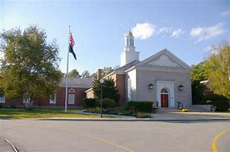
THE JUDICIAL BRANCH
SUPREME COURT BUILDING

Slide 9
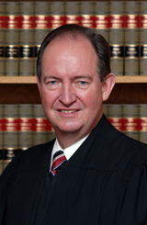
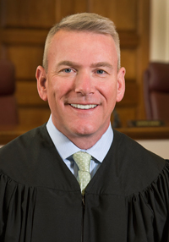
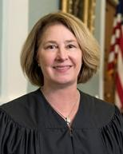
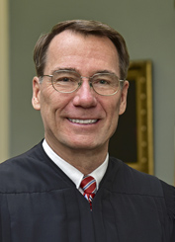
SUPREME COURT JUSTICES
Senior Associate
Justice Gary E. Hicks
Associate Justice
Patrick E. Donovan
Associate Justice
Anna Barbara Hantz Marconi
Associate Justice
James P. Bassett
SUPREME COURT BUILDING

Slide 10
The Judicial Branch is made up of three levels of courts.
The Circuit Court deals with small crimes such as traffic violations and family disputes.
The Superior Court holds jury trials for more serious crimes that include violence. These crimes are called felonies.
The highest level is the New Hampshire Supreme Court which hears appeals from the lower courts.
Each court is run by a judge, or “Justice”. Judges are the heads of the courtroom and decide which evidence can be used in a trial.
When the Legislative Branch passes a law, the Judicial Branch studies it, and decides if it follows the rules of our state Constitution.
The Executive Branch appoints judges and they serve until they retire,
reach the age of 70, or are removed from office.

Slide 11
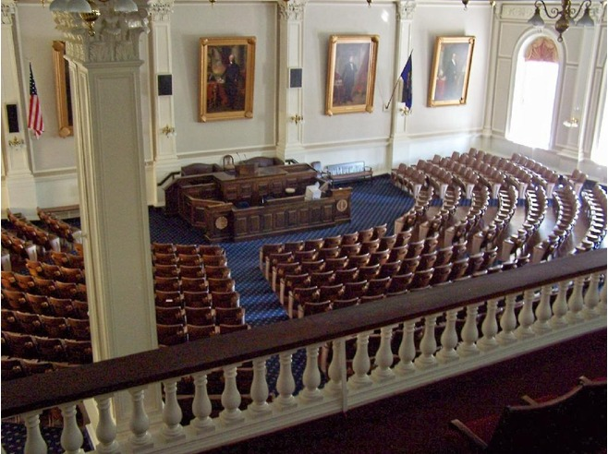
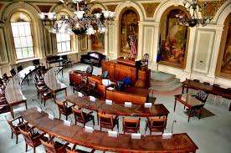
THE LEGISLATIVE BRANCH
THE SENATE
THE HOUSE OF REPRESENTATIVES

Slide 12
New Hampshire’s Legislative Branch is also known as the New Hampshire
General Court.
It is made up of two chambers called the Senate and House of Representatives.
The Senate has 24 Senators and the House of Representatives has 400 Representatives. We have the second largest legislature in the country, following the United States Congress. Each Senator or Representative is elected by the people of the district, or area they represent. They are elected for two year terms.
The Legislative Branch’s job is to make new laws for the state. A law begins as a bill written by Senators and Representatives. After a bill is approved by a vote of the members of the Senate and the House, the bill is sent to the Governor who heads the Executive Branch. The Governor can approve and sign the bill and turn it into law, or veto (reject) the bill so that it will not become a law at that time. The Legislative Branch can override the Governor’s veto with a ⅔ vote of the Senate and House of Representatives.
When a law is passed, the Judicial Branch reviews it to be sure it follows
the rules of New Hampshire’s Constitution.

Slide 13

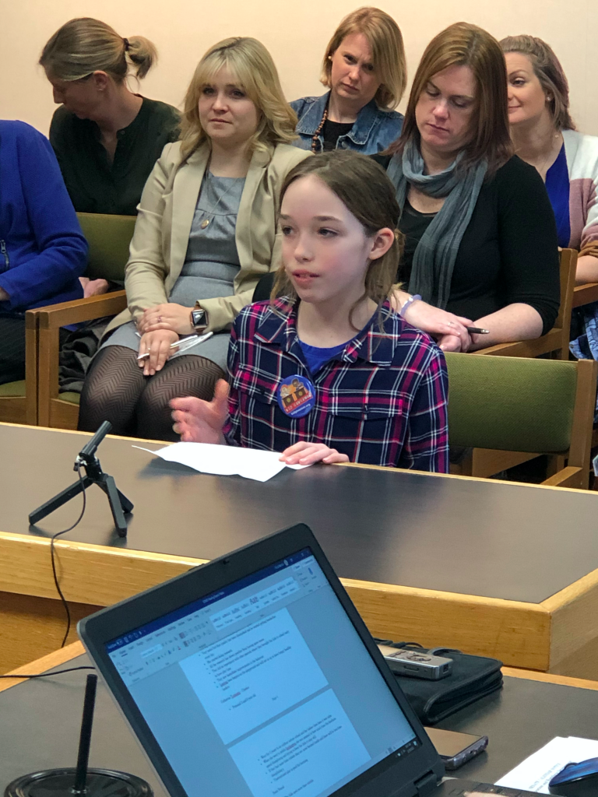
New Hampshire Students Take Action
NH’s 2020 Kid Governor, Suzy Brand, spoke before a group of legislators in favor of forming a committee to study increasing recess time for NH students.

Slide 14
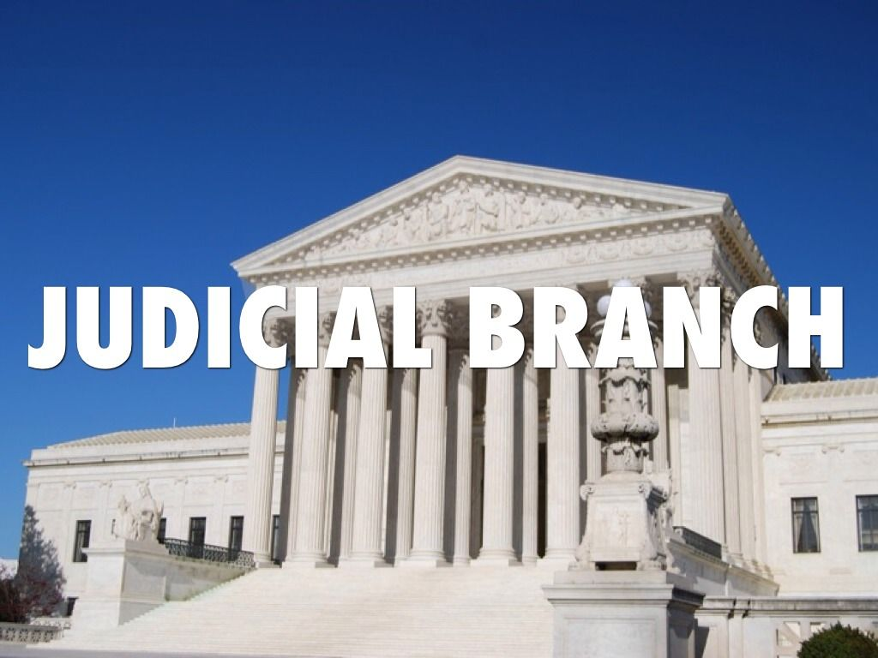
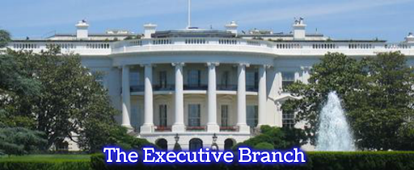
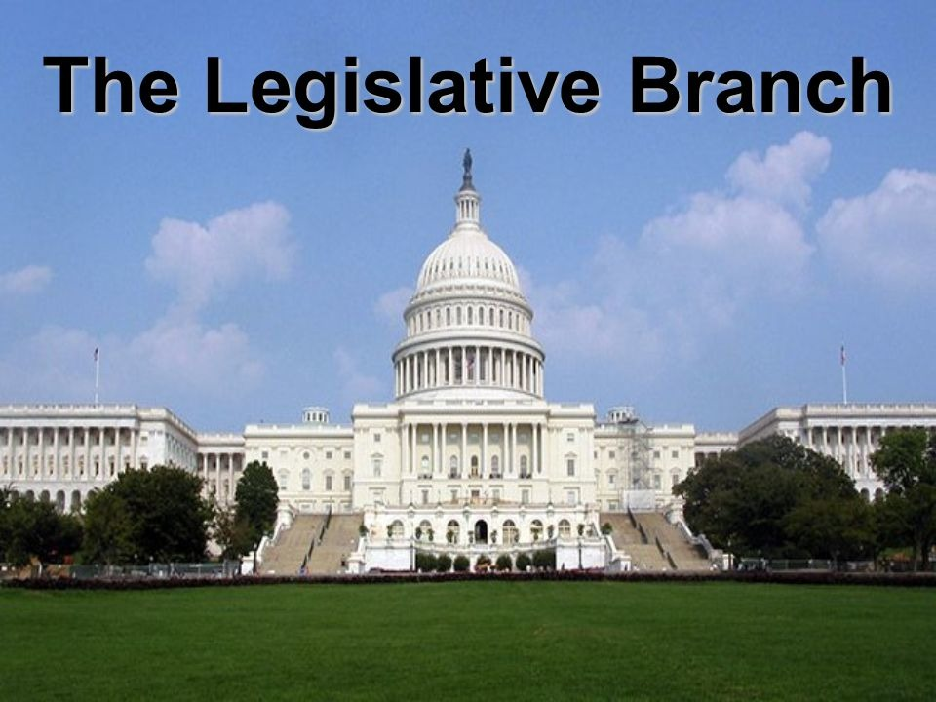
Click and drag the vocabulary word under the Branch of Government to which it belongs.
GOVERNOR
SUPERIOR COURT
CIRCUIT COURT
STATE AGENCIES
EXECUTIVE COUNCIL
HOUSE OF REPRESENTATIVES
SUPREME COURT JUSTICES
SENATE

